Slide 1
Informational Cards (for group activity)
Print 1 copy of Slide 2 (“Origins and Primary Regions of Diversity”) for every student in class
All other slides can be printed with enough copies for each member of the expert group to have a copy. (For example, in a class of 25, which will be broken down into 5 groups, print five copies of each).

Slide 2
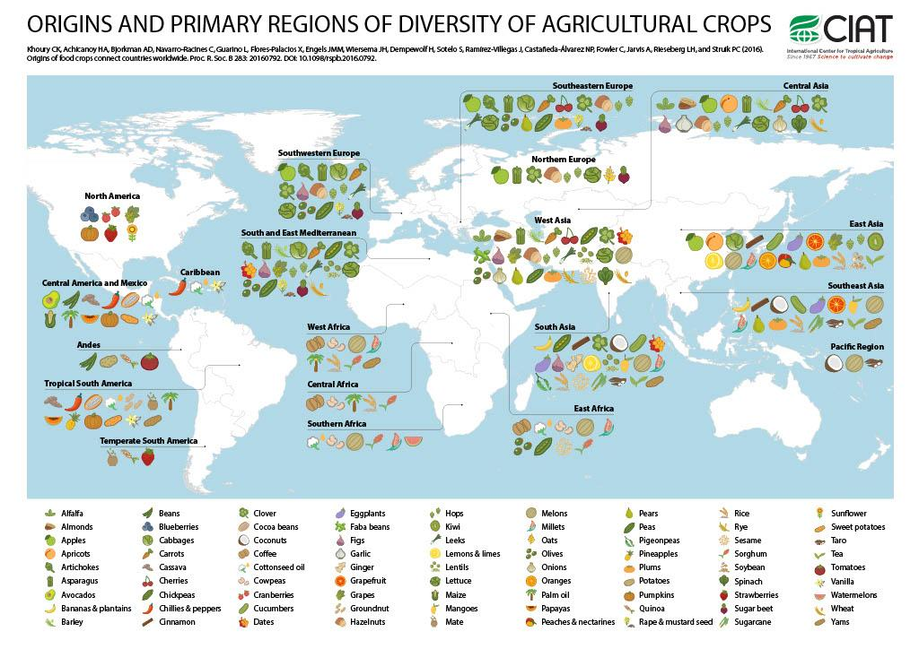
Where did some of the key ingredients of your special dish come from?

Slide 3
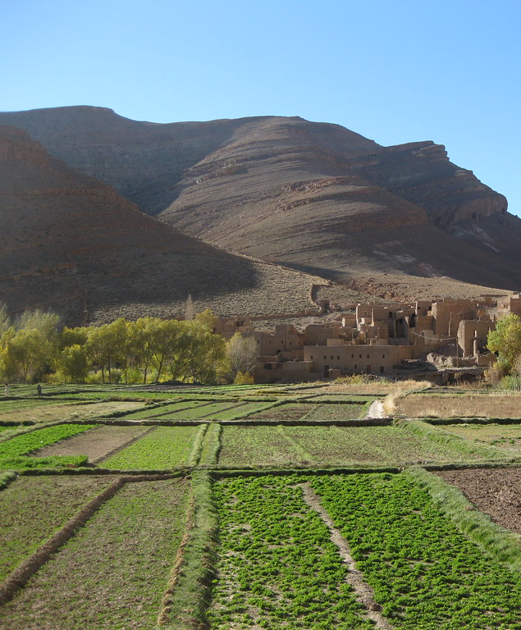
Staple crops are especially important
Staple crop: Makes up a large portion of the nutritional needs and/or economy of a region. Familiar examples of staple crops include:
  Potatoes
  Rice
  Wheat
  Corn
  Acorns
But how well do you know these crops? What do the plants look like that these foods come from?
What growing conditions do they require?
Notes:
Photo credits: "Crop Fields" by MrHicks46 is licensed under CC BY-SA 2.0.

Slide 4
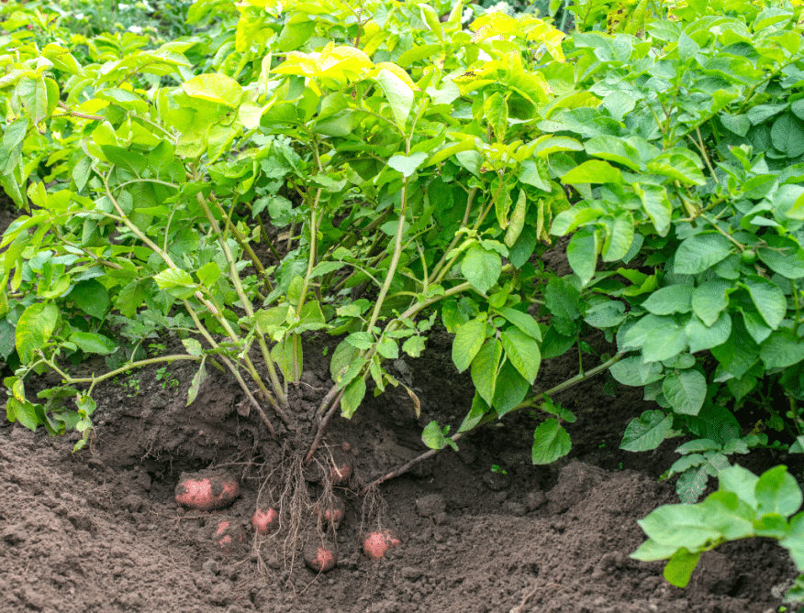
Potatoes (Solanum tuberosum)
Native geographic region & climate:
  The Andean highlands of South America, especially present-day Peru and Bolivia.
Grown today:
  Global distribution in temperate regions; major producers include China, India, Russia, Ukraine, and the U.S. (Pacific Northwest).
Human-cultivation:
  Andean farmers traditionally grow dozens to hundreds of potato landraces at once on terraced fields, using “chuño” processing (freeze-drying in the open air) to store potatoes for years.
Ecological interactions:
  The potato’s wild relatives co-evolved with various leaf beetles (e.g., Leptinotarsa spp.), and modern potatoes still rely on chemical defenses (glycoalkaloids) that deter herbivory. Some of these chemicals can be toxic to humans.
  Why did the Irish Potato Famine happen? It has to do with how potatoes are propagated.
Notes:
Photo credits: "Crop Fields" by MrHicks46 is licensed under CC BY-SA 2.0.

Slide 5
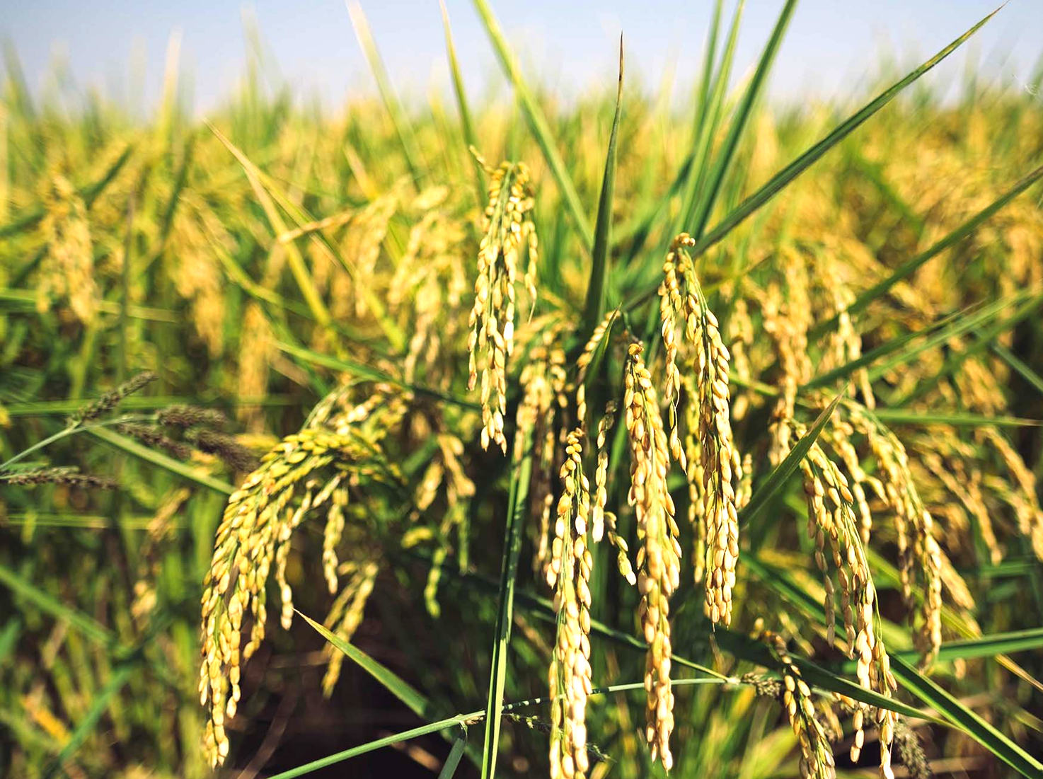
Rice (Oryza sativa and O. glaberrima)
Native geographic region: 2 major species
  O. sativa originated in the Yangtze River valleys of China.
  O. glaberrima was domesticated in West Africa.
Grown today:
  Widespread in tropical and subtropical regions; major producers include China, India, Indonesia, Bangladesh, Vietnam, Thailand, as well as Arkansas, Louisiana, Mississippi, and California.
Human-cultivation:
  Much rice is grown in flooded paddies, which creates anaerobic soil conditions conducive to rice varieties with specialized air-channel tissues (aerenchyma). Humans essentially engineer wetland conditions to favor rice over competitors.
Ecological interaction:
  Traditional Asian rice paddies often host fish, ducks, and nitrogen-fixing floating micro-ferns (Azolla). How might this relate to regenerative agriculture practices?
  Crayfish native to the southeastern US have invaded rice fields in the Central Valley. Consequences?

Slide 6
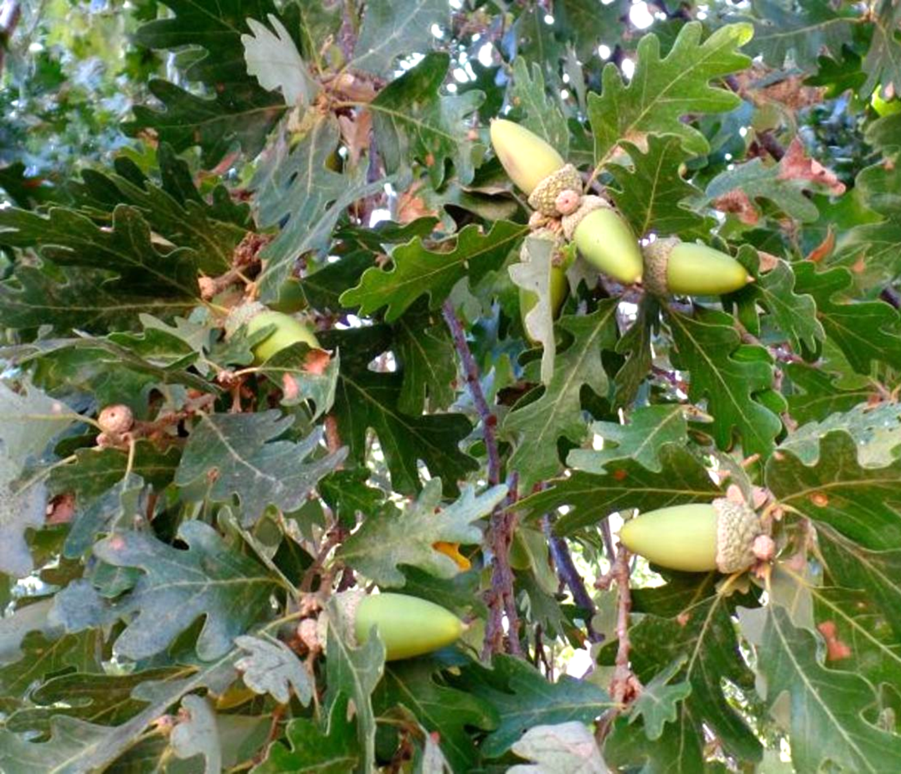
Acorns (Quercus species)
Native geographic region:
  In temperate & tropical areas with sufficient rainfall; 20 species occur in California, including valley oak, black oak, blue oak, coast live oak, and even an unrelated acorn-producing tree, tanoak (Notholithocarpus).
Grown today:
  Wild and restoration plantings across California’s woodlands, savannas, and chaparral ecosystems. Some tribes and land stewards actively cultivate or encourage favored trees and groves.
Human-cultivation:
  Indigenous Californians managed oak woodlands with regular low-intensity cultural burns. How did fire affect acorn production?
  Valley oaks are one of the largest oaks in the world, and were sometimes dynamited by colonizers to remove them.
Ecological interaction:
  Oak trees are often considered keystone species because they support so many other species. They produce tannins, which must be removed before humans and some animals can eat them. Acorn woodpeckers create granary trees with thousands of stored acorns, influencing local predator and insect communities.
Notes:
Photo credits: "Crop Fields" by MrHicks46 is licensed under CC BY-SA 2.0.

Slide 7
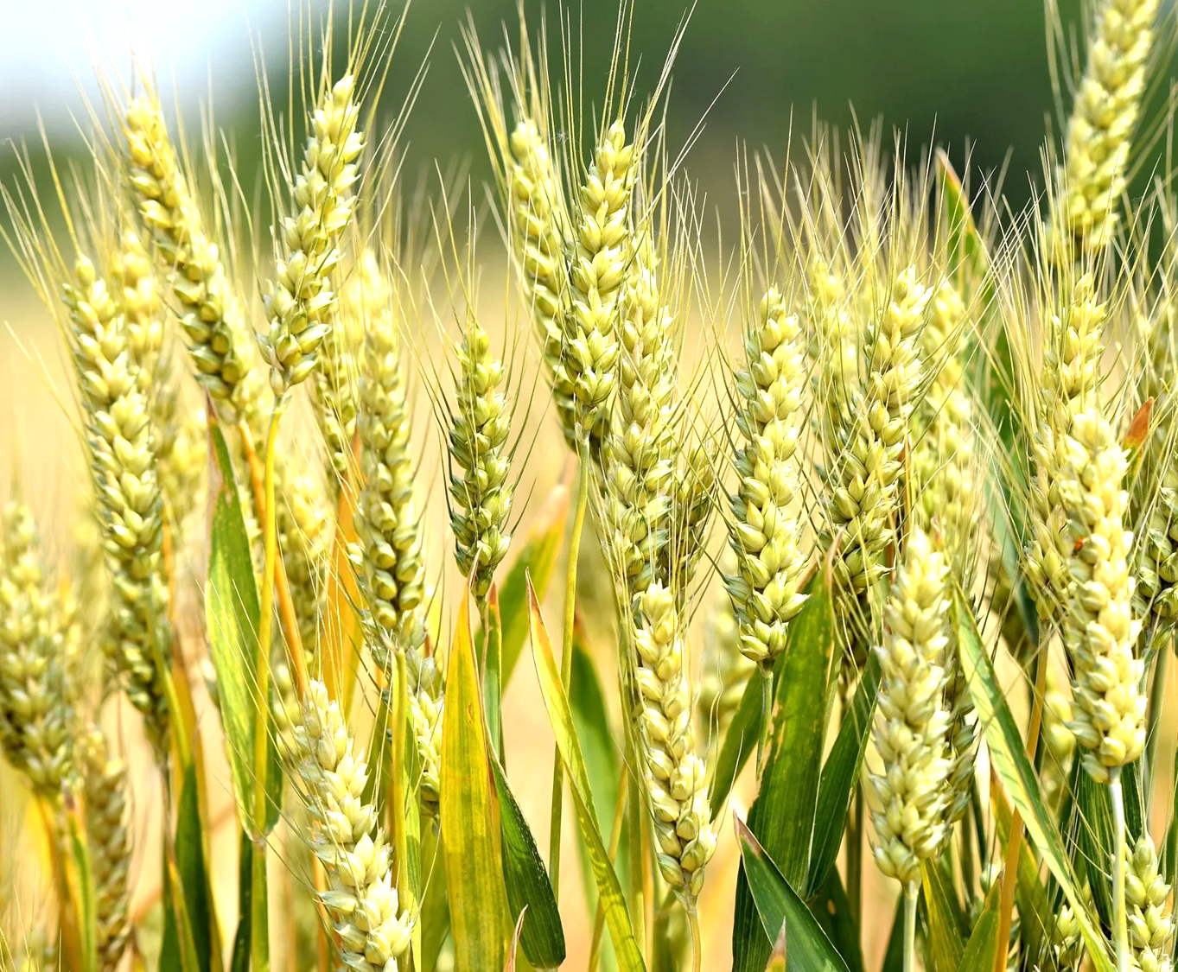
Wheat (Triticum aestivum and related species)
Native geographic region:
  The Fertile Crescent of the Middle East (modern Iraq, Syria, Turkey), first cultivated ~10,000-12,000 years ago.
Grown today:
  Global distribution in temperate climates; major producers include China, India, Russia, the U.S., Canada, and Australia.
Human-cultivation:
  Common bread wheat is an allopolyploid—a hybrid of multiple ancestral grasses with multiple sets of chromosomes. This unusual genome made wheat exceptionally adaptable and created the gluten proteins crucial for bread-making.
Ecological interaction:
  Wheat engages in a notable mutualism with arbuscular mycorrhizal fungi. The fungi expand the plant’s effective root system and improve phosphorus uptake, while receiving sugars in return.
Notes:
Photo credits: "Crop Fields" by MrHicks46 is licensed under CC BY-SA 2.0.

Slide 8
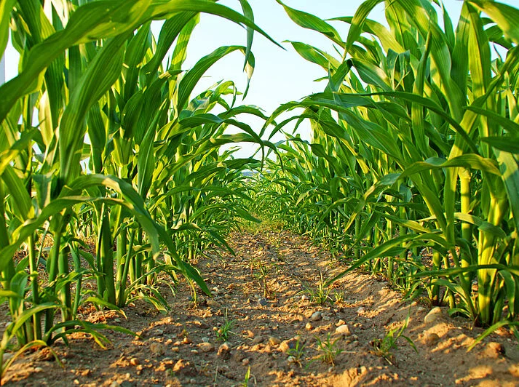
Corn (Zea mays)
Native geographic region:
  Mesoamerica, especially southern Mexico; domesticated from the wild grass teosinte around 9,000 years ago.
Grown today:
  Worldwide in temperate and tropical climates. Major producers include the U.S., China, Brazil, and Argentina.
Human-cultivation:
  Rather than shattering off the plant when ripe, corn seeds are tightly bound to the cob, a trait selected by early agriculturalists.
Ecological interactions:
  Maize roots release volatile chemicals when attacked by herbivores like corn borers. These volatiles attract parasitic wasps (such as Cotesia spp.) that prey on the herbivore—an example of plant signaling recruiting animal “bodyguards.”
  Corn smut
Notes:
Photo credits: "Crop Fields" by MrHicks46 is licensed under CC BY-SA 2.0.

Slide 9
Matrix
Crop | Native Geographic Region | Where Grown Today | Human Cultivation Note | Ecological Interaction
Potatoes | Andes of Peru & Bolivia | Temperate regions worldwide; major in China, India, Russia, U.S. | Andean farmers traditionally freeze-dry potatoes into chuño for long-term storage. | Wild relatives and pests shaped potato chemical defenses (glycoalkaloids).
Corn (Maize) | Mesoamerica (southern Mexico) | Worldwide in temperate & tropical zones; major in U.S., China, Brazil | Domestication made kernels unable to disperse naturally—maize depends entirely on humans to propagate. | Attacked roots release volatiles that attract parasitic wasps to kill herbivores.
Wheat | Fertile Crescent (Middle East) | Global temperate regions; China, India, Russia, U.S., Canada | Bread wheat is an allopolyploid, giving it adaptability and gluten properties. | Forms mutualisms with arbuscular mycorrhizal fungi for nutrient exchange.
Rice | Yangtze River Valley (China) and West Africa | Widespread in tropical & subtropical regions; Asia especially | Flooded paddy cultivation suppresses weeds and favors rice’s aerenchyma adaptation. | Traditional paddy systems often include fish that provide pest control and fertilization.
Acorns (California Oaks) | California Floristic Province | Native woodlands & restoration sites across California | Indigenous cultural burning enhances acorn yield and reduces pests. | Scrub jays and acorn woodpeckers disperse and store acorns, influencing oak regeneration.

Slide 10
Matrix
What crop: |  | Corn | Wheat | Potatoes | Rice | Acorns
Where did the plant evolve/where was it first domesticated into a crop?
Where is it grown today?
Under what conditions? Do we have to alter the places where it is grown?
Ecological interactions (with wildlife, etc)

