Slide 1
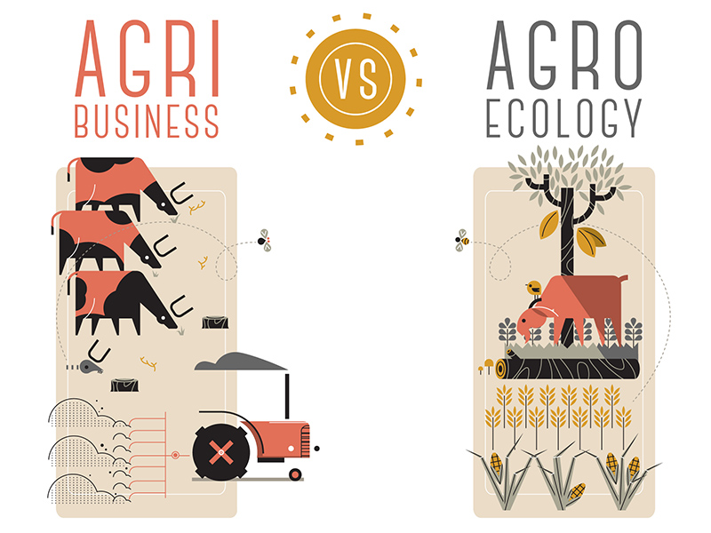
Food Systems
Where does our food
come from?
Notes:
Image attribution: https://commons.wikimedia.org/wiki/File:Agribusiness_vs_agroecology.jpg
Pablo Peiker, CC0, via Wikimedia Commons

Slide 2

Today’s Activities
Reflect & Share: Meaningful Meals
Mini-Lecture: Crop Origins & Staple Crops
Group Research: Staple Crop
Jigsaw: Share Research in New Group
Mini-Lecture: Ecosystems and Agriculture
Wrap-Up Discussion
Notes:
Image attribution: https://commons.wikimedia.org/wiki/File:Agribusiness_vs_agroecology.jpg
Pablo Peiker, CC0, via Wikimedia Commons

Slide 3
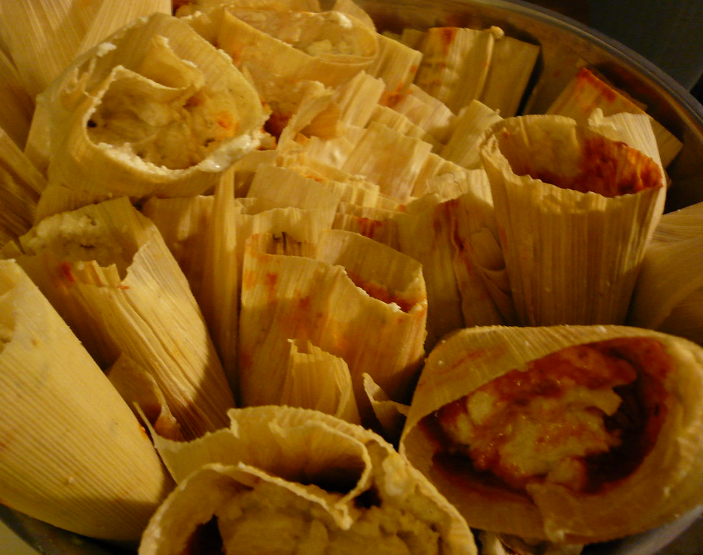
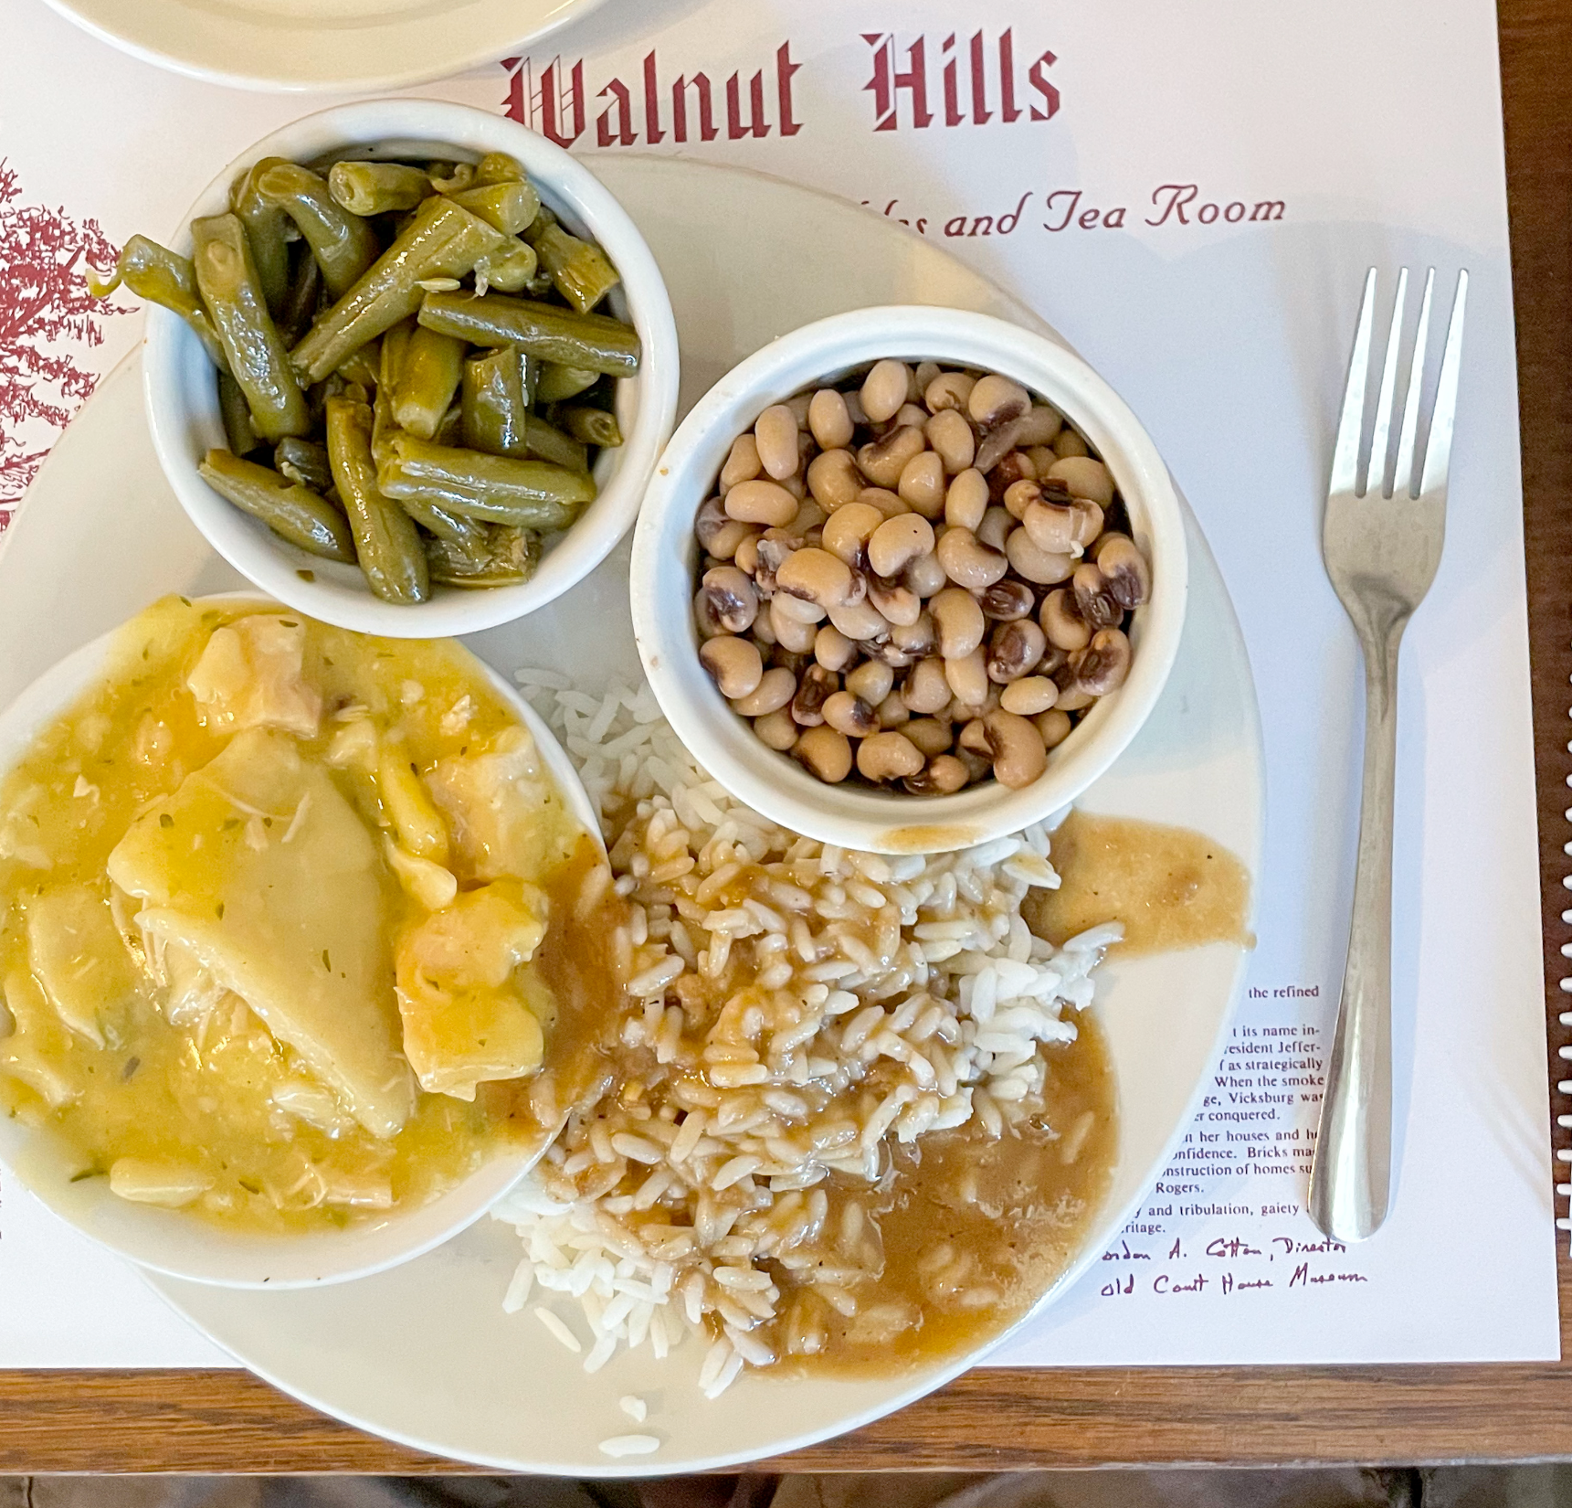
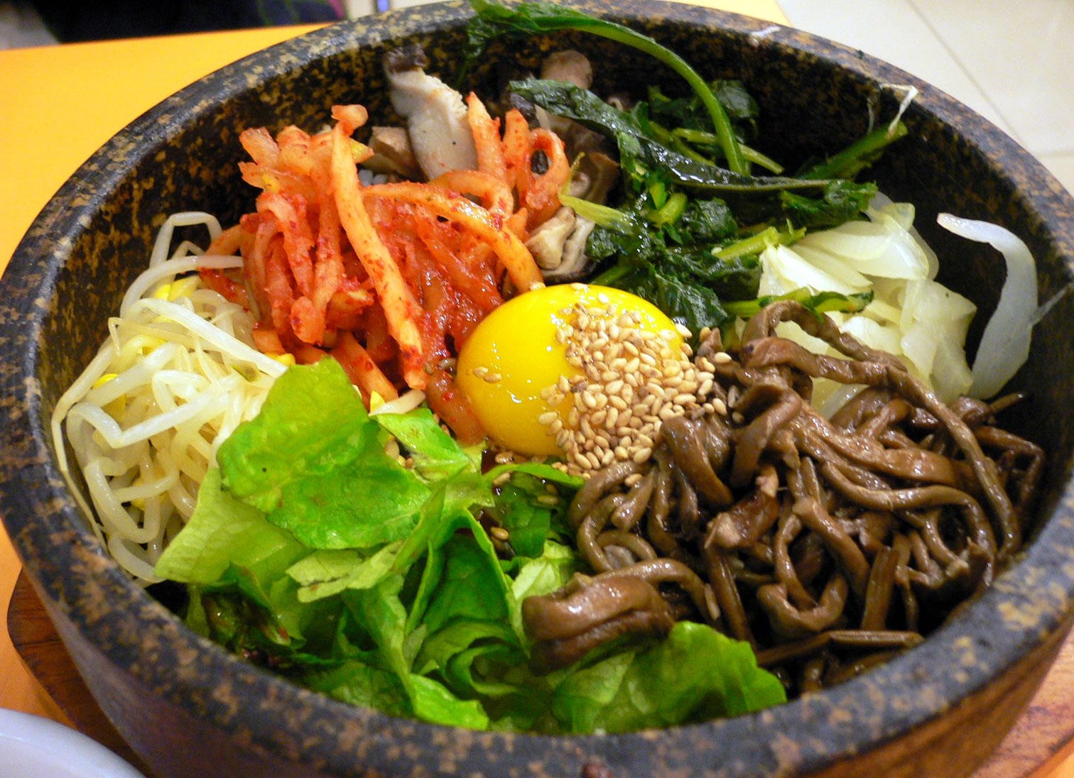
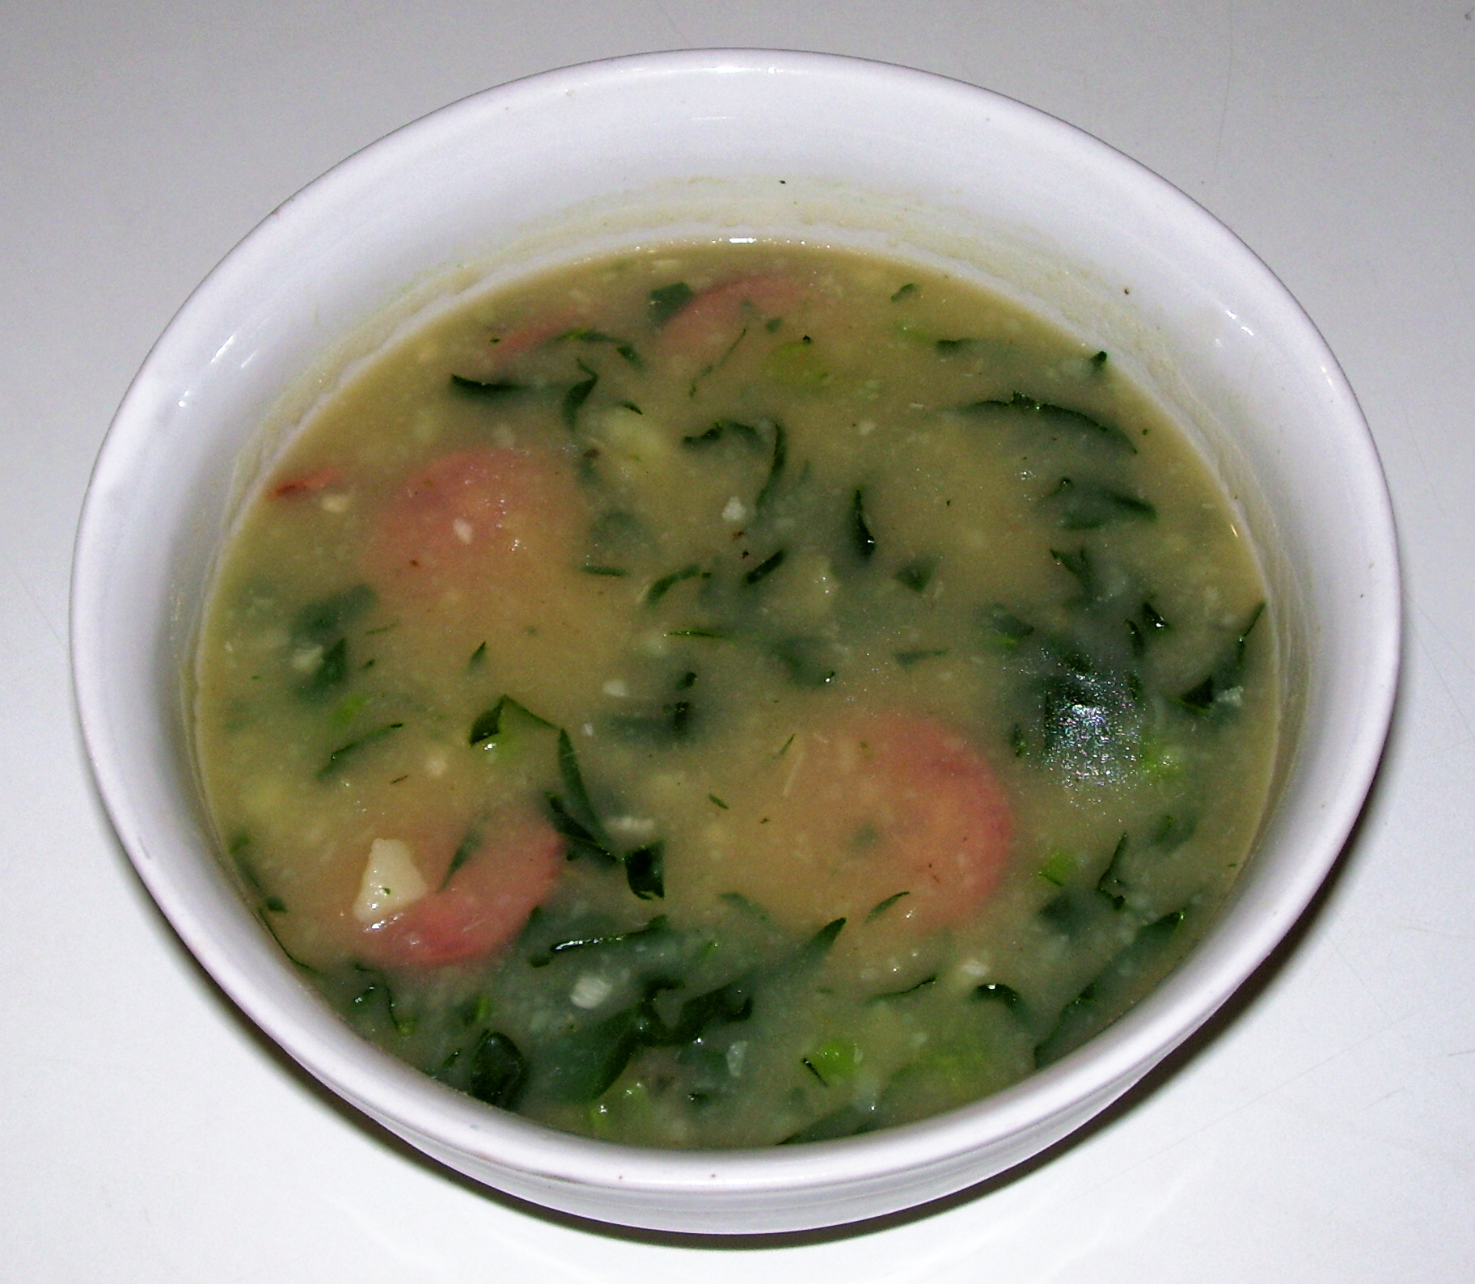
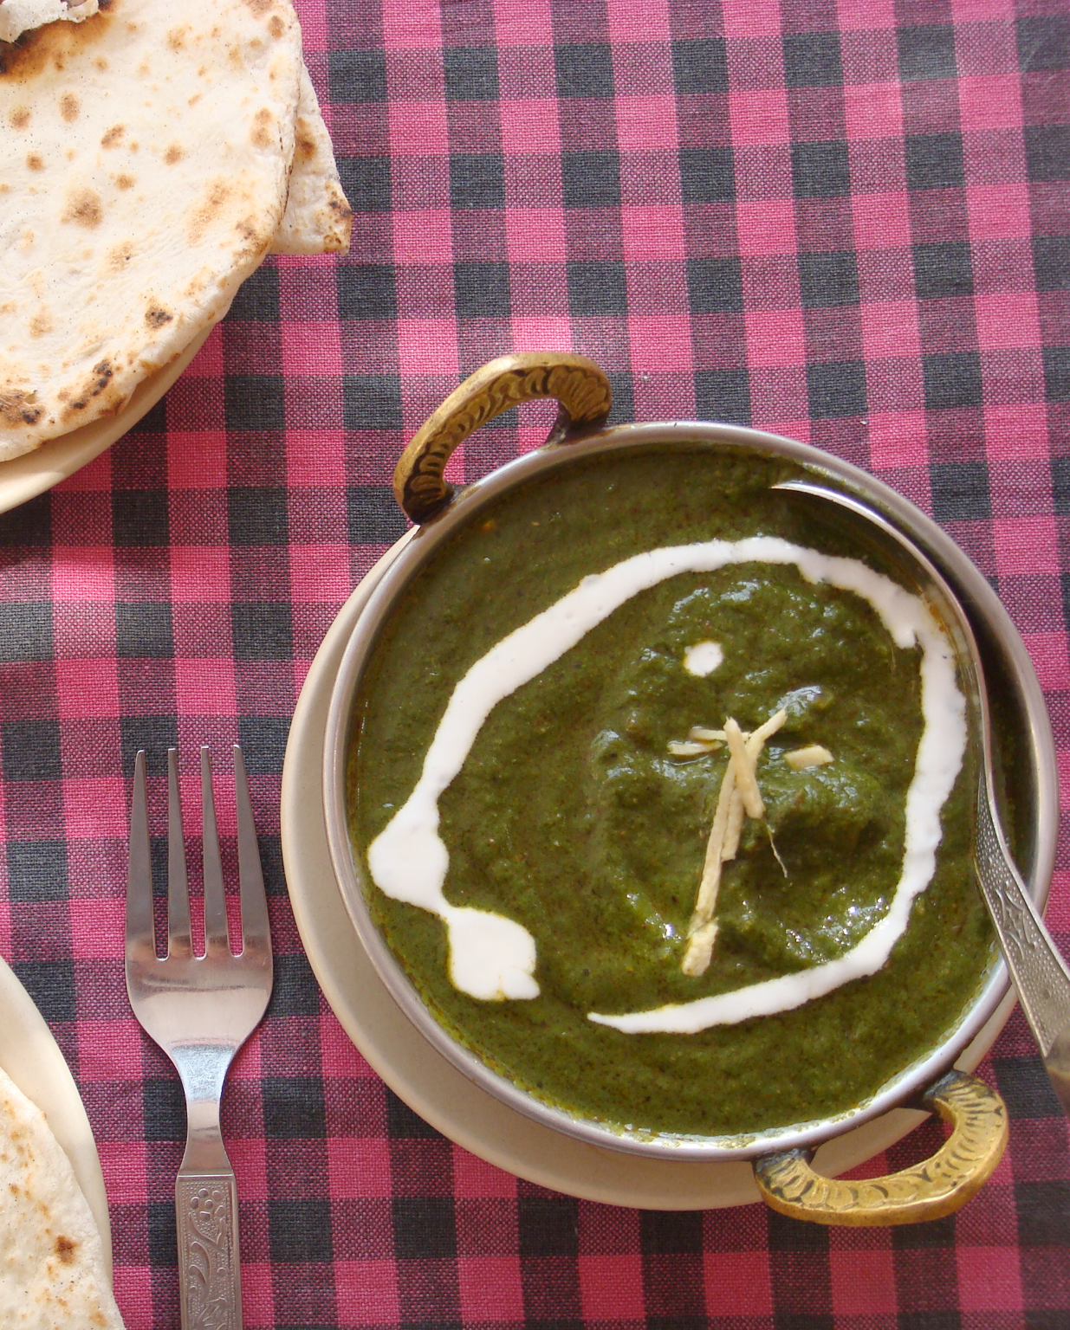
Individual Reflection: A Meaningful Meal
Close your eyes and think of a favorite dish in your life, connected to your family or your culture.
Imagine the dish –how it looks, smells, & tastes.
Write what you know about key ingredients:
  Type of organism (plant, animal, fungus)?
  Where do some of the ingredients come from?
Notes:
Prompts for small group/partner discussion
Dishes pictured: green chile tamales (Mexico, Central America), “meat and three” (southern USA), caldo verde (Portugal), bibimbap (Korea), saag (Punjab)
"Christmas Tamales #4" by rvacapinta is licensed under CC BY 2.0.
"Meat and three at Walnut Hills restaurant" by Kenneth C. Zirkel is licensed under CC BY-SA 4.0.
"Caldo verde" by Mateus Hidalgo is licensed under CC BY-SA 2.5.
"File:Korean.food-Bibimbap-02.jpg" by abex (a flickr user) is licensed under CC BY-SA 2.0.

Slide 4
Group Discussion: A Meaningful Meal
Take turns sharing out your meal and ingredients to your group. Describe the details; feel free to share non-English names.
Describe your dish–how it looks, smells, tastes.
Share what you know about some key ingredients.
Invite others to share what they know about your dish or key ingredients.
Notes:
Prompts for small group/partner discussion
Dishes pictured: green chile tamales (Mexico, Central America), “meat and three” (southern USA), caldo verde (Portugal), bibimbap (Korea), saag (Punjab)
"Christmas Tamales #4" by rvacapinta is licensed under CC BY 2.0.
"Meat and three at Walnut Hills restaurant" by Kenneth C. Zirkel is licensed under CC BY-SA 4.0.
"Caldo verde" by Mateus Hidalgo is licensed under CC BY-SA 2.5.
"File:Korean.food-Bibimbap-02.jpg" by abex (a flickr user) is licensed under CC BY-SA 2.0.

Slide 5
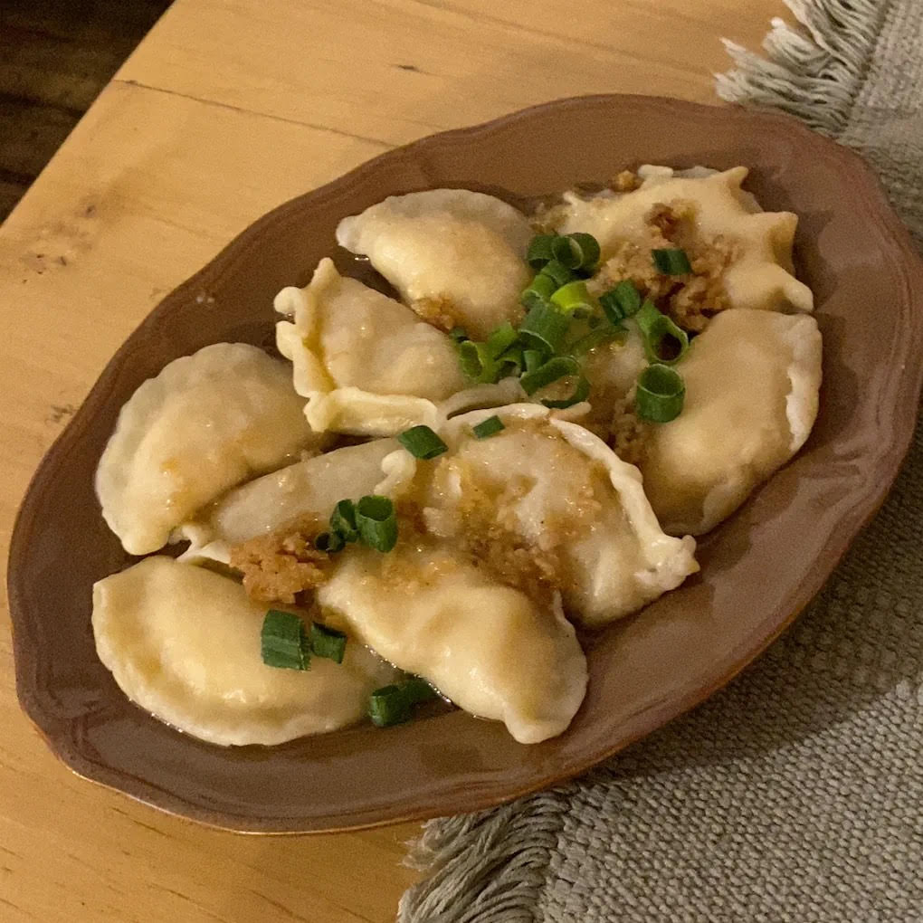
Wendy’s Meaningful Meal
Pierogies (from Poland)
  Potato* dough dumplings
  Filled with cabbage or shredded beef
  Boiled, then pan-fried in butter and breadcrumbs
  Served with sour cream
*Native to Andes; arrived in Poland late 17th c
Notes:
This is my own meal, that I shared with the class after they’d done the initial share out.
Potatoes arrived in Poland: 1683
Photo attribution: Dotruonggiahy12, CC BY-SA 4.0 <https://creativecommons.org/licenses/by-sa/4.0>, via Wikimedia Commons

Slide 6
Reflection: Windows & Mirrors
Free Write: How does hearing other people’s stories about foods make you feel about your connections to foods?
How were their stories similar to yours? How different?
Did listening to other stories bring up more memories for you?
Notes:
Prompts for small group/partner discussion
Dishes pictured: green chile tamales (Mexico, Central America), “meat and three” (southern USA), caldo verde (Portugal), bibimbap (Korea), saag (Punjab)
"Christmas Tamales #4" by rvacapinta is licensed under CC BY 2.0.
"Meat and three at Walnut Hills restaurant" by Kenneth C. Zirkel is licensed under CC BY-SA 4.0.
"Caldo verde" by Mateus Hidalgo is licensed under CC BY-SA 2.5.
"File:Korean.food-Bibimbap-02.jpg" by abex (a flickr user) is licensed under CC BY-SA 2.0.

Slide 7

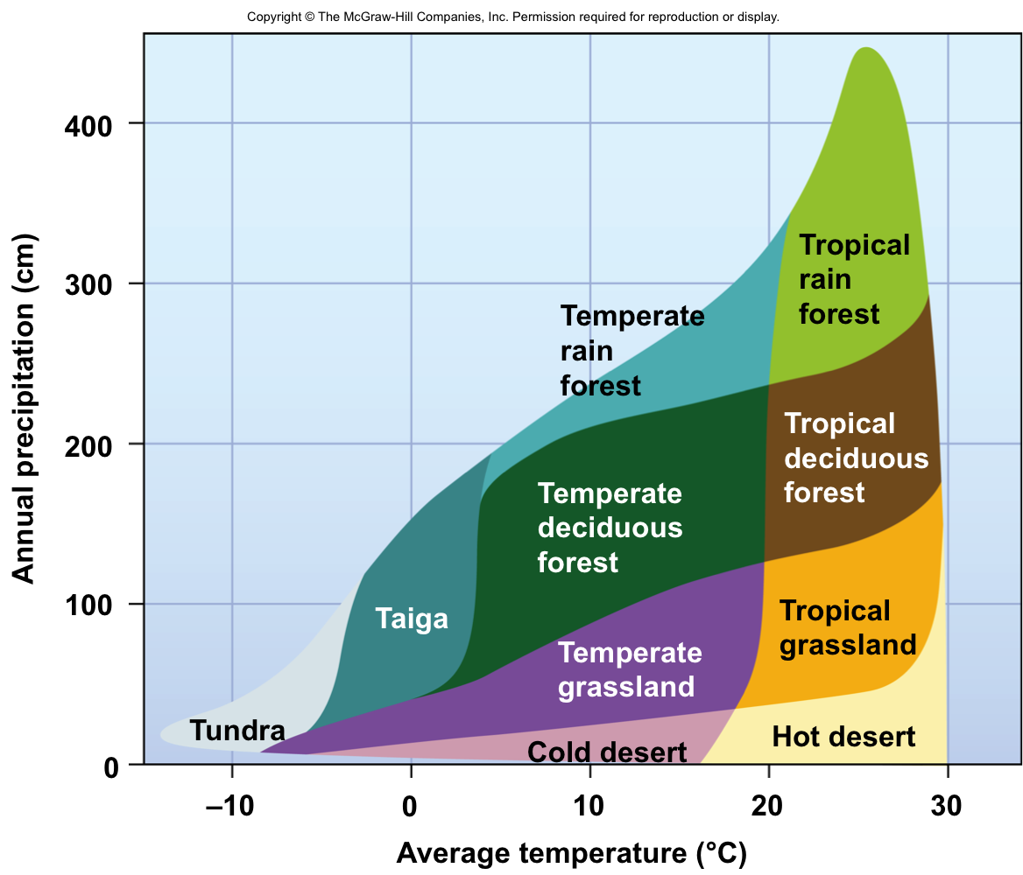
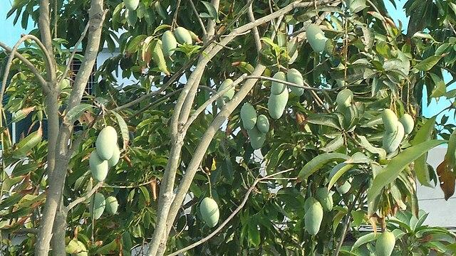
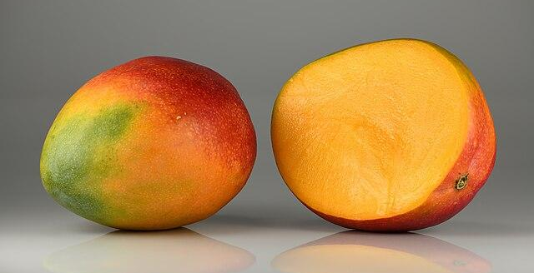
Example: Where do Mangos Grow?
Notes:
Image attributions
Mango tree: Masum Ibn Musa, CC BY-SA 4.0 https://commons.wikimedia.org/wiki/File:Mango_tree_with_a_lot_of_mangoes_of_Khulna,_Bangladesh.JPG
Mango: Ivar Leidus, CC BY-SA 4.0 https://commons.wikimedia.org/wiki/File:Mangos_-_single_and_halved.jpg
Biome Diagram: Wendy St. John, after Robert Whittaker. CC BY-SA 4.0

Slide 8
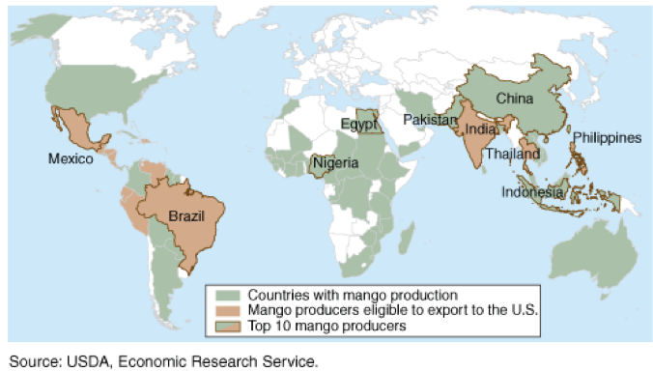
In tropical areas with high rainfall
Origin of Mangifera indica in NE India, Bangladesh, and Myanmar
Notes:
Mangoes are believed to have originated from the region between northwestern Myanmar, Bangladesh, eastern and northeastern India. M. indica were domesticated separately in India and Southeast Asia over centuries, resulting in two distinct genetic populations in modern mangoes – the "Indian type" and the "Southeast Asian type".^{[4][16][17]}

Slide 9
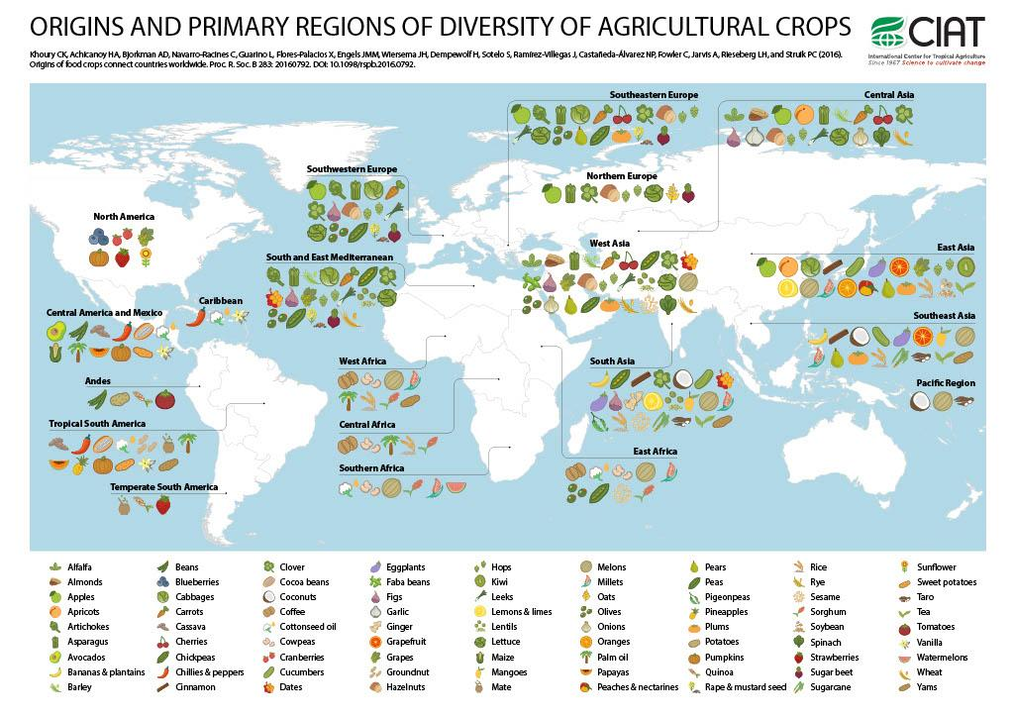
Think-Pair-Share
How have crop origins influenced different cuisines?
To what extent have crops moved beyond their origin locations? Why?
Notes:
Make color copies as a handout

Slide 10
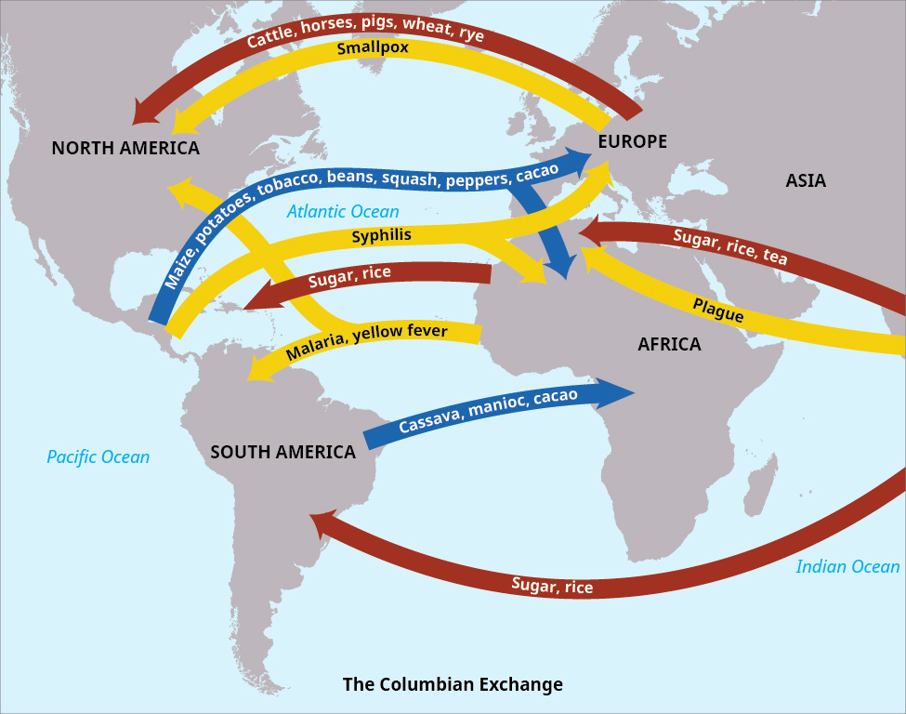
Trade routes existed over 10,000 years within regions around the world, but the Columbian Exchange (late 15th century onward) drove massive changes in cuisines & cultures around the world:
crops, livestock, enslaved people, diseases, & wealth in just a few hundred years.
Notes:
Widespread transfer of plants, animals, and diseases between the New World (the Americas) in the Western Hemisphere, and the Old World (Afro-Eurasia) in the Eastern Hemisphere, from the late 15th century on. It is named after the explorer Christopher Columbus and is related to the European colonization and global trade following his 1492 voyage. Image attribution: Copyright Rice University, OpenStax, under CC BY 4.0 license.

Slide 11
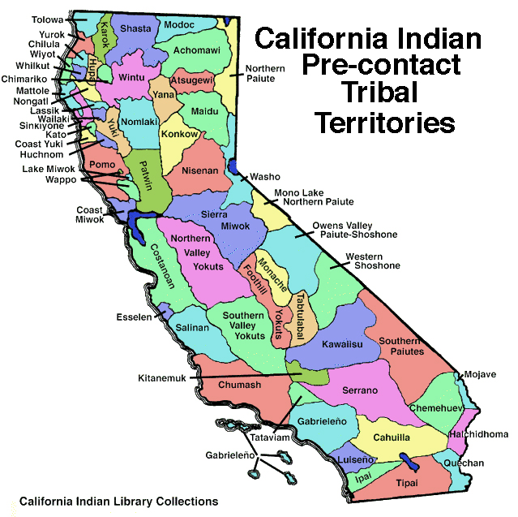
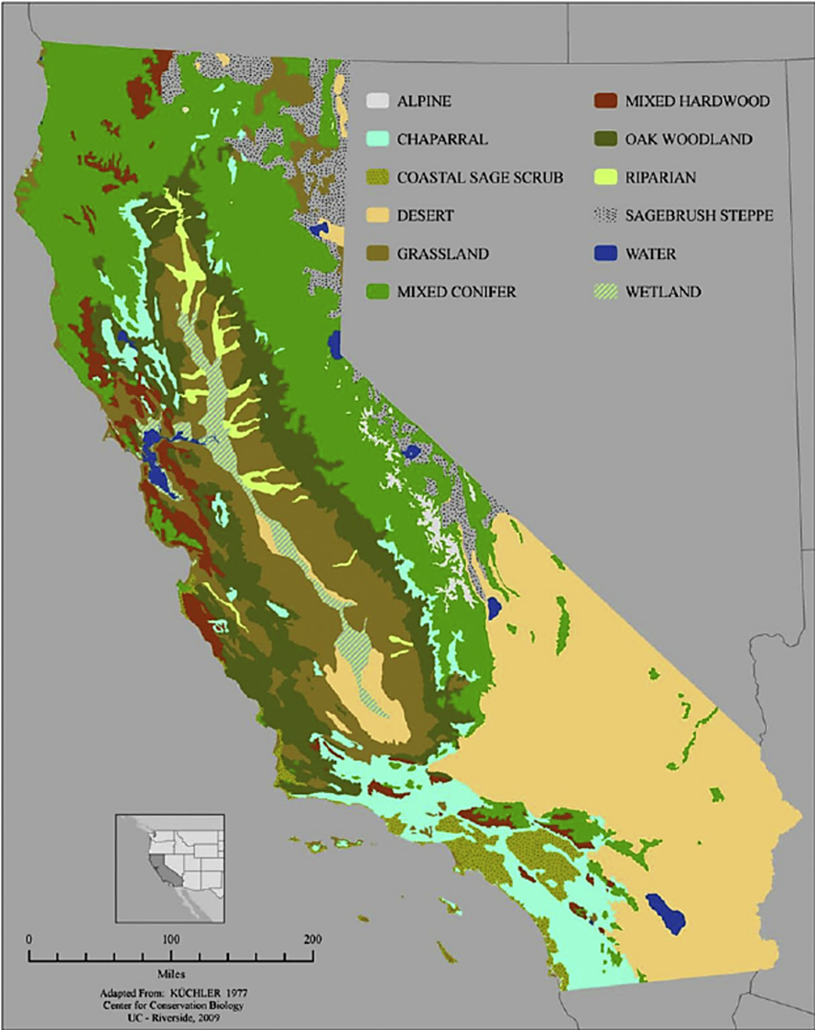
What are some traditional indigenous foods across different regions of California?
California supports:
  Desert
  Alpine tundra
  Temperate rainforest
  Widespread Mediterranean climate along the coast and in the Central Valley
Climate largely depends on:
  Elevation
  Latitude
  Proximity to the coast
Notes:
Map of the distribution of vegetation types and land cover in California (U.S. Bureau of Reclamation, 1996)
Tribal Territories map: https://aimfireriversideca.tripod.com/sitebuildercontent/sitebuilderpictures/calprecontact.gif

Slide 12
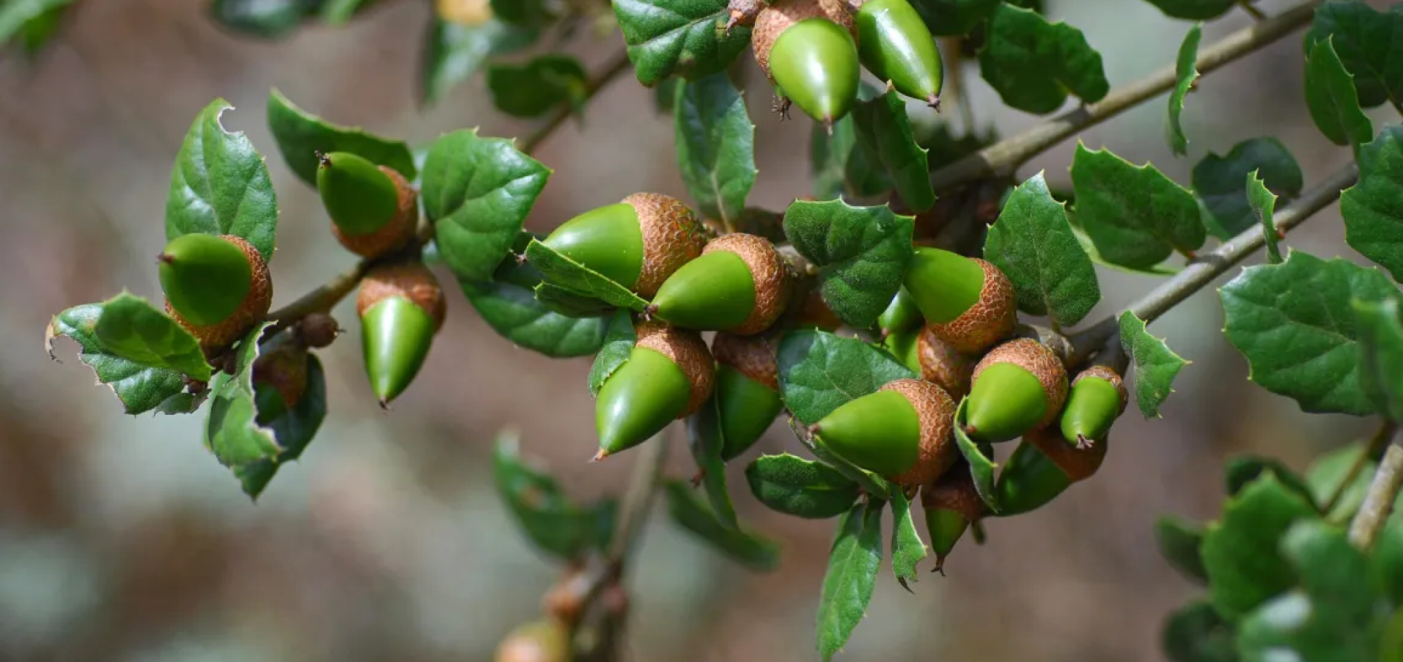
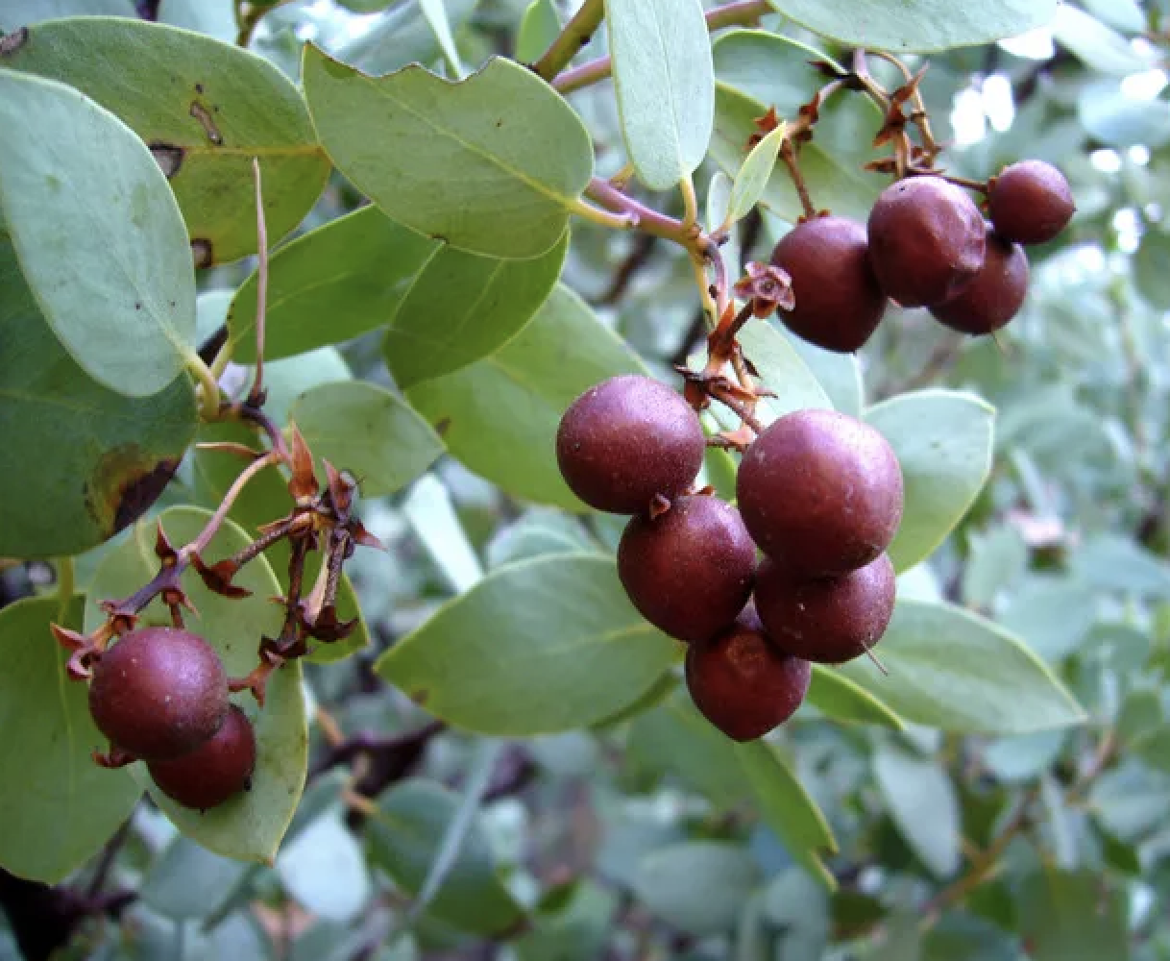
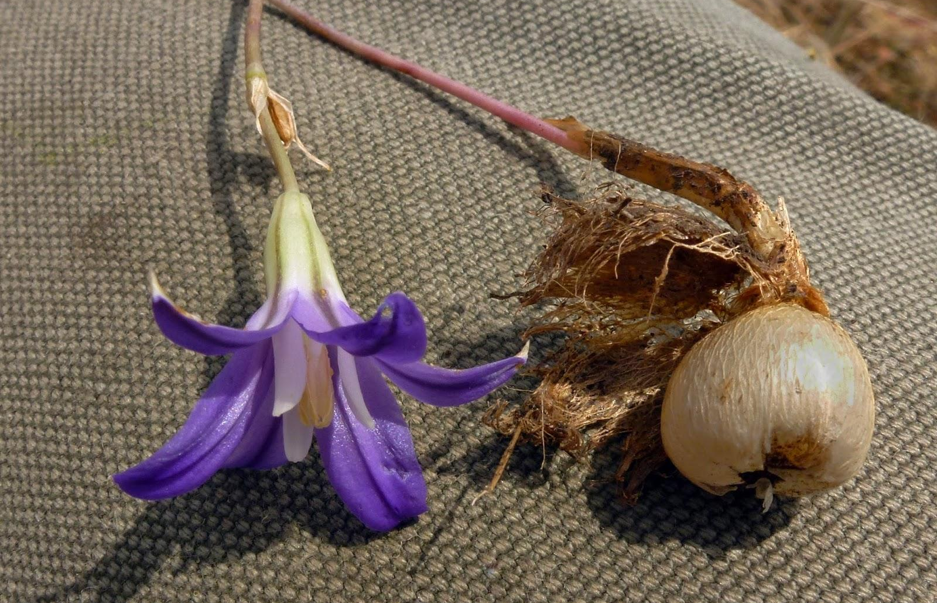
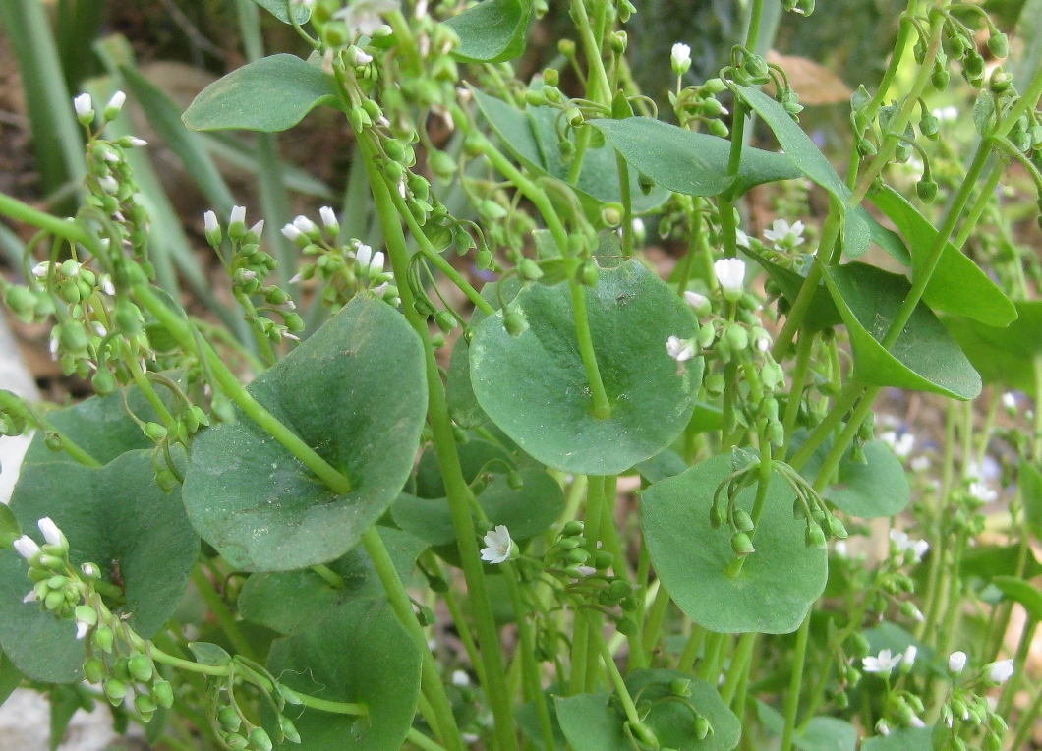
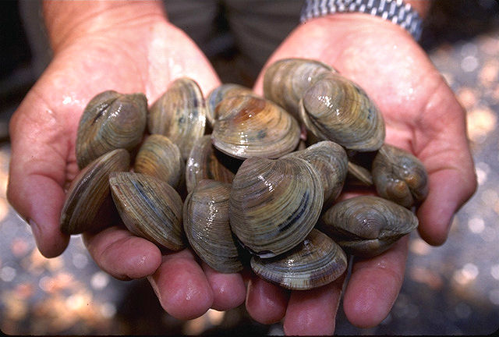
Common indigenous foods in different regions of CA
NORTH COAST
Acorns
Seeds: Chia, various grasses & forbs, pine nuts, walnuts
Fruits: Manzanita, blackberry, grape, strawberry, blue & red elderberry, salmonberry
Roots & Tubers: biscuitroot, yampah, brodiaea, triteleia
Greens: Miner’s lettuce, cattails & others
Animals: shellfish, salmon, deer
Notes:
Acorns: Bri Weldon https://www.flickr.com/photos/41184028@N04/5169665251
Brodiaea: https://arcadianabe.blogspot.com/2014/06/harvest-brodiaea.html
Littleneck clams: Ken Hammond, Public domain, via Wikimedia Commons
Manzanita: The thumbnail photo (128x192 pixels) on this page may be freely used for personal or academic purposes without prior permission under the Fair Use provisions of US copyright law as long as the photo is clearly credited with © 2008 Zoya Akulova.
Miner’s Lettuce: https://sierrafoothillgarden.com/2011/02/25/springs-ephemerals-in-the-sierra-foothills/

Slide 13
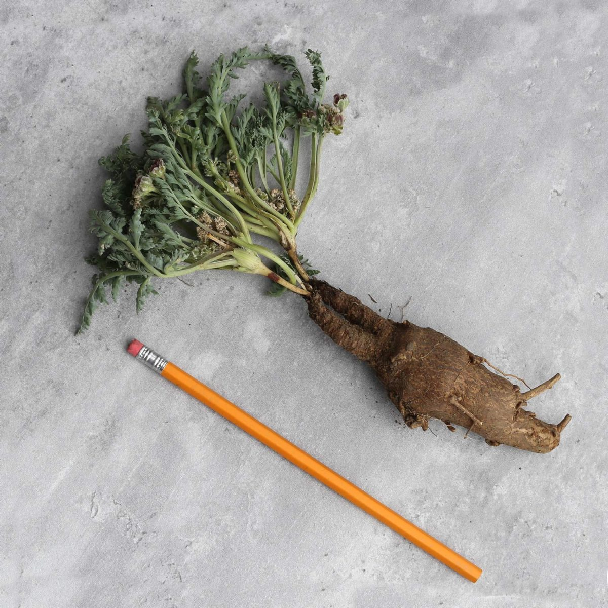
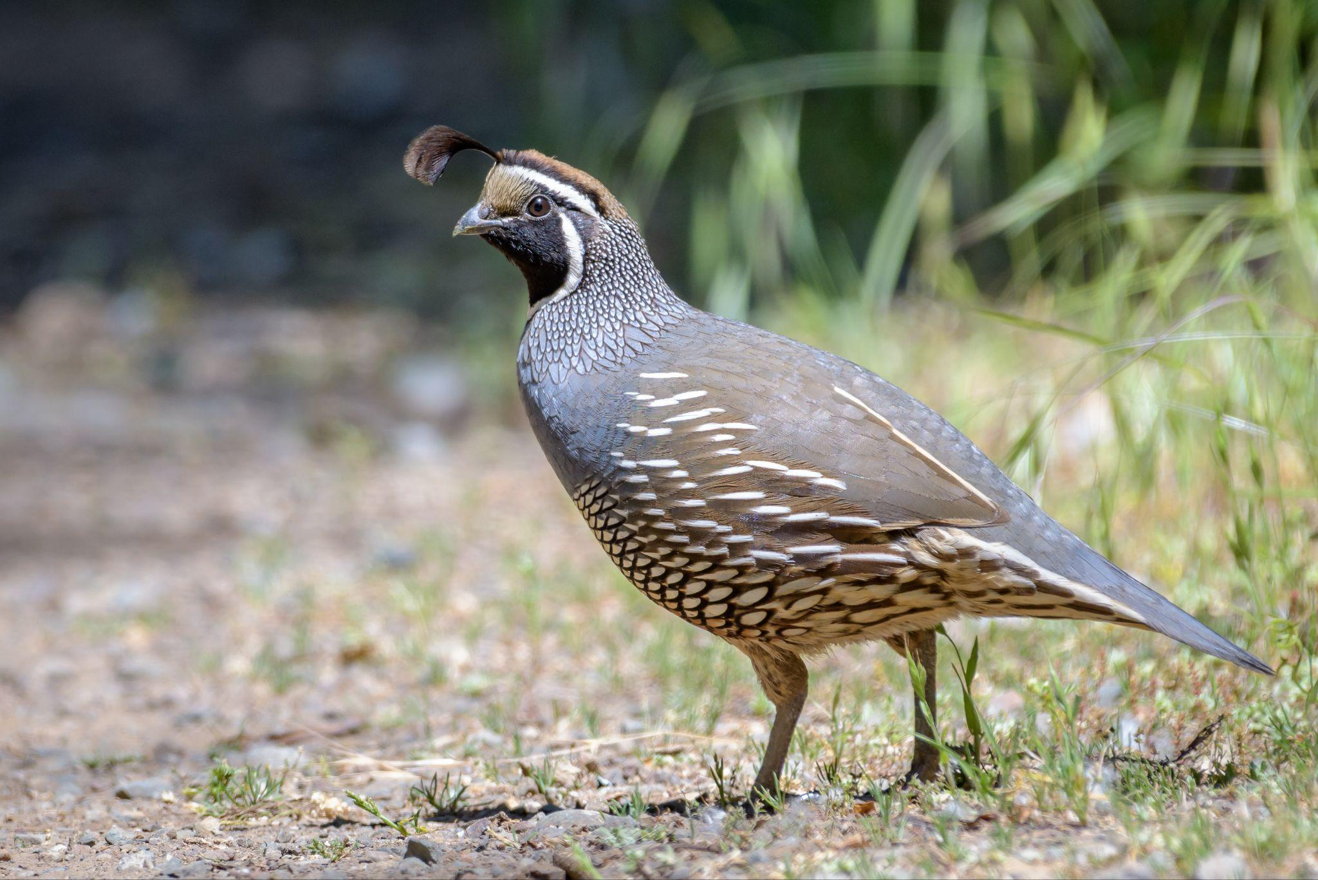
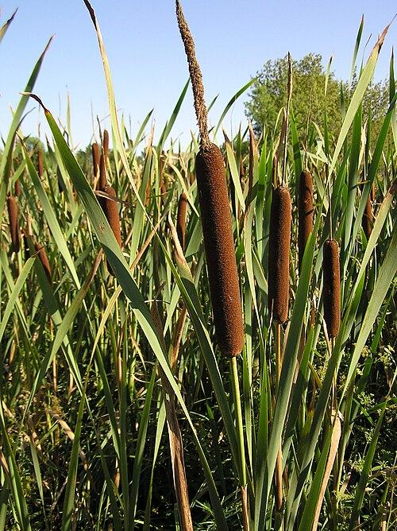
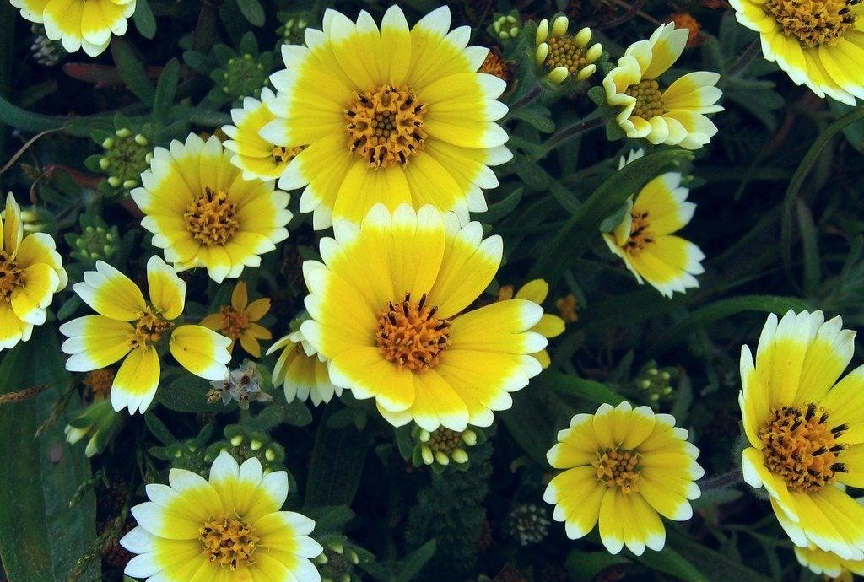
Common indigenous foods in different regions of CA
CENTRAL VALLEY
Acorns
Seeds: Chia, red maids, tidytips, sunflowers & various grasses & forbs
Fruits: Blackberry, grape, blue elderberry, strawberry
Roots & Tubers: biscuitroot, yampah, brodiaea, triteleia
Greens: Miner’s lettuce, cattails & others, milkweed pods
Animals: salmon, deer, water birds, quail
Notes:
Acorns: Bri Weldon https://www.flickr.com/photos/41184028@N04/5169665251
California quail: Becky Matsubara from El Sobrante, California, CC BY 2.0 <https://creativecommons.org/licenses/by/2.0>, via Wikimedia Commons
Tidytips: Dawn Endico https://www.flickr.com/photos/51035743246@N01/149603309
Biscuitroot: https://wildfoodgirl.com/product/web-class-biscuitroots/
Cattails: Le.Loup.Gris, CC BY-SA 3.0 <https://creativecommons.org/licenses/by-sa/3.0>, via Wikimedia Commons

Slide 14
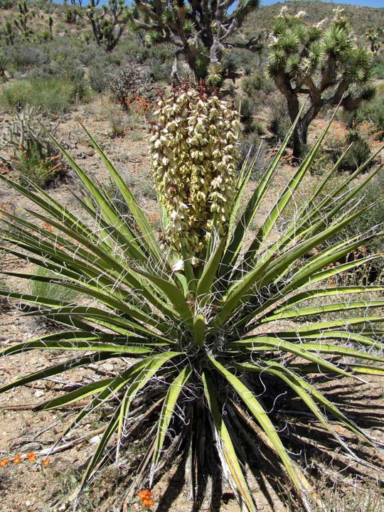
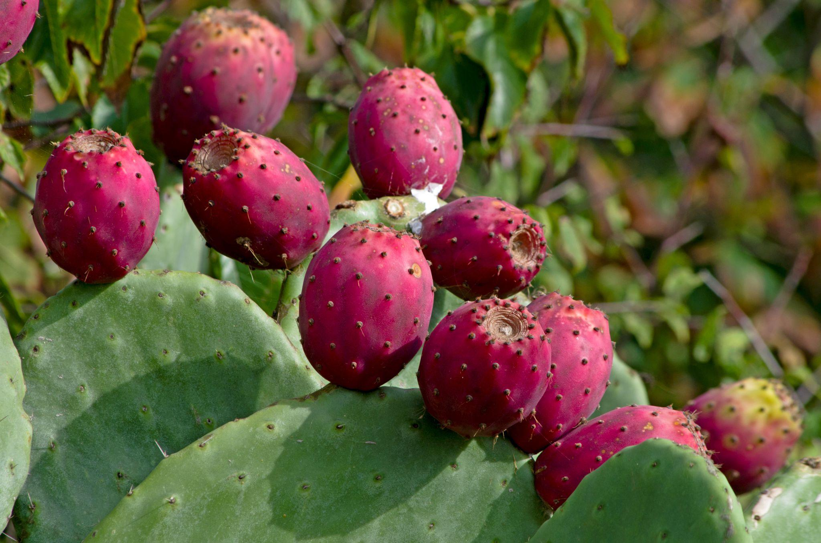
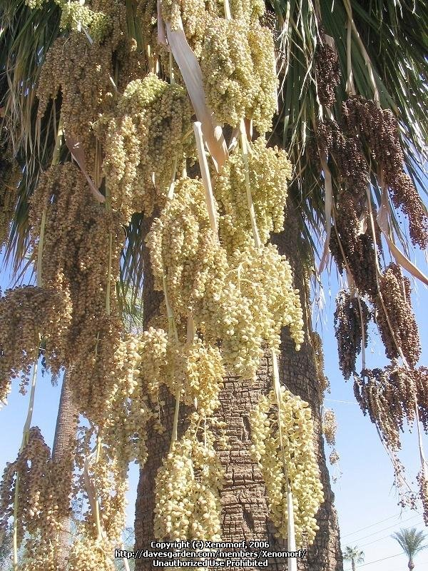
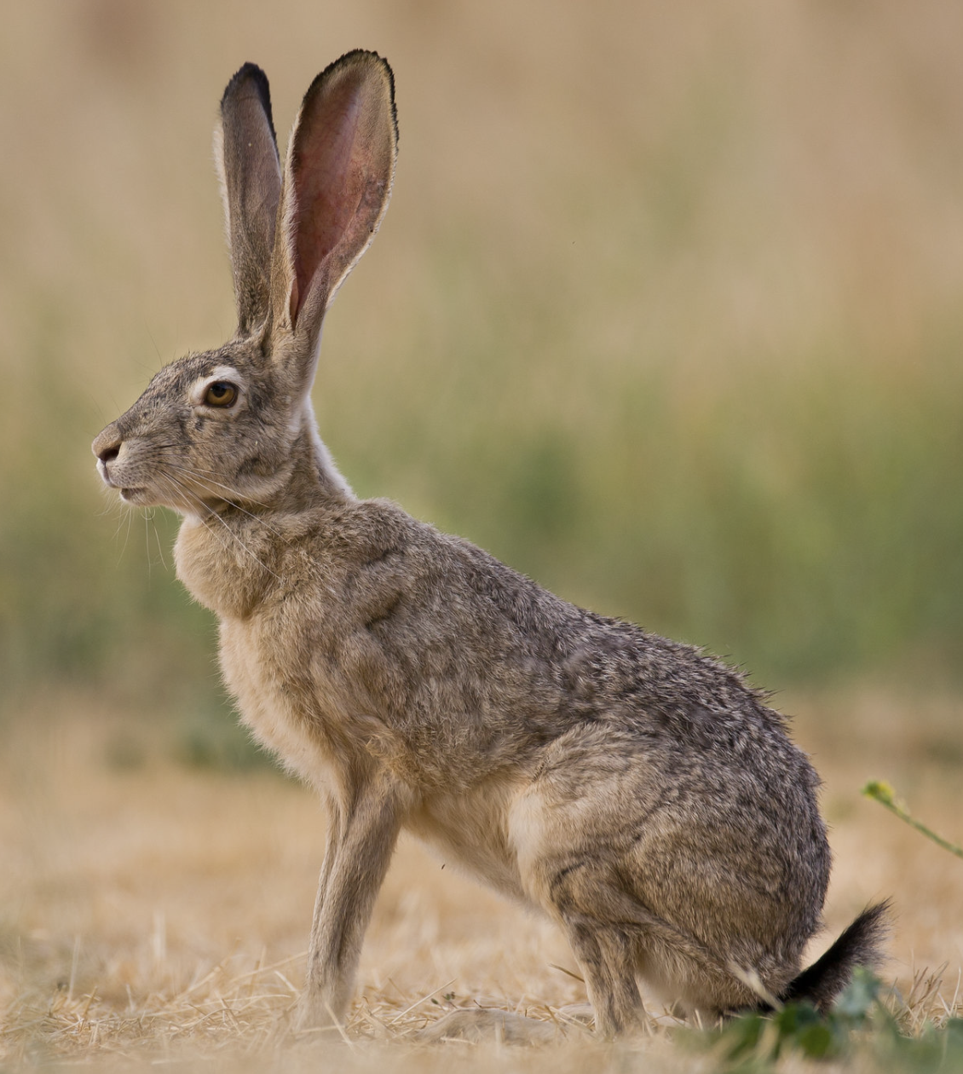
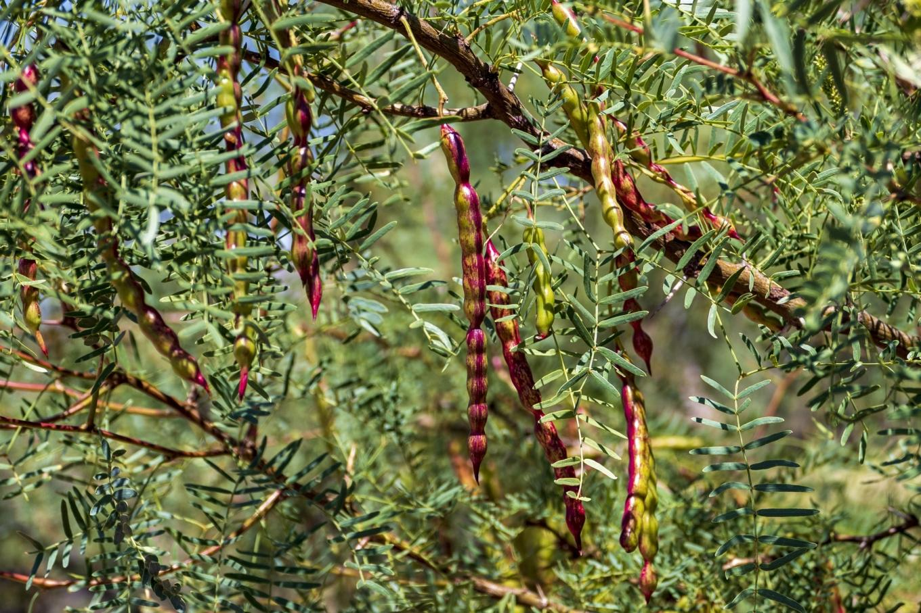
Common indigenous foods in different regions of CA
DESERT
Acorns
Seeds: Mesquite, pinyon pine, chia, nutsedge, California fan palm, cactus, corn
Fruits: Manzanita, wild cherry, cactus, California fan palm, prickly pear
Roots & Tubers: brodiaea, biscuitroot, agave, yucca, wild onion & garlic
Greens: cacti, annual mustards
Animals: small mammals
Notes:
Acorns: Bri Weldon https://www.flickr.com/photos/41184028@N04/5169665251
Mesquite: https://pixabay.com/photos/mesquite-tree-pods-desert-texas-5346579/
California Fan Palm: http://davesgarden.com/members/Xenomorf/
Yucca: https://ru.pinterest.com/pin/17-unique-yucca-plants-how-to-take-care-of-them--478437160419990342/
Black-tailed Jackrabbit: Morgan Ball https://www.flickr.com/photos/73564082@N08/8959988674
Prickly pear: https://ru.pinterest.com/pin/how-to-care-for-prickly-pear-complete-landscaping--457185799689554310/

Slide 15
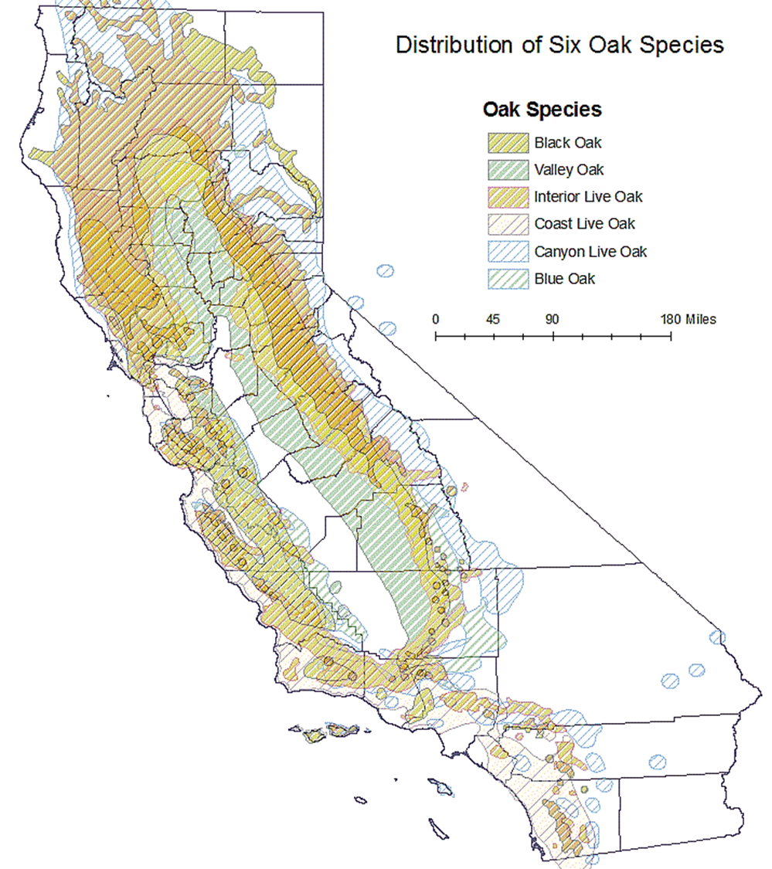
Common indigenous foods in different regions of CA
Maize (corn) was only grown in SE CA, near rivers
Colorado River Valley:
  Quechan (Yuma) used seasonal river flooding to grow corn, beans & squash (las tres hermanas) near present-day Arizona
Southeastern CA/Great Basin:
  Paiute had irrigated cornfields along rivers (present-day Riverside to Nevada/Death Valley area)
Notes:
The Three Sisters (Spanish: tres hermanas) are the three main agricultural crops of various indigenous peoples of Central and North America: squash, maize ("corn"), and climbing beans (typically tepary beans or common beans). Traditionally, several Native American groups also planted sunflowers on the north edges of their gardens as a "fourth sister"
Map: https://ic.arc.losrios.edu/~veiszep/24fall2010/Herrig/G350_Herrig_Project.htm

Slide 16
Acorns: a major staple crop in most of California
Oak woodlands were/are foundational ecosystems across California
Acorns were a primary staple food for indigenous people
  High in carbohydrates and fats
  Harvested seasonally and stored long-term
Oak landscapes were actively managed using cultural burning and tending
Acorns supported not just people, but entire ecological communities (wildlife, fungi, insects)
Distribution of 6 common CA Oaks
Notes:
“Oak woodlands were not untouched wilderness — they were managed food landscapes.”
Processed into acorn mush, bread, and soup
Tannins were leached from ground acorn meal to remove bitterness and toxicity

Slide 17
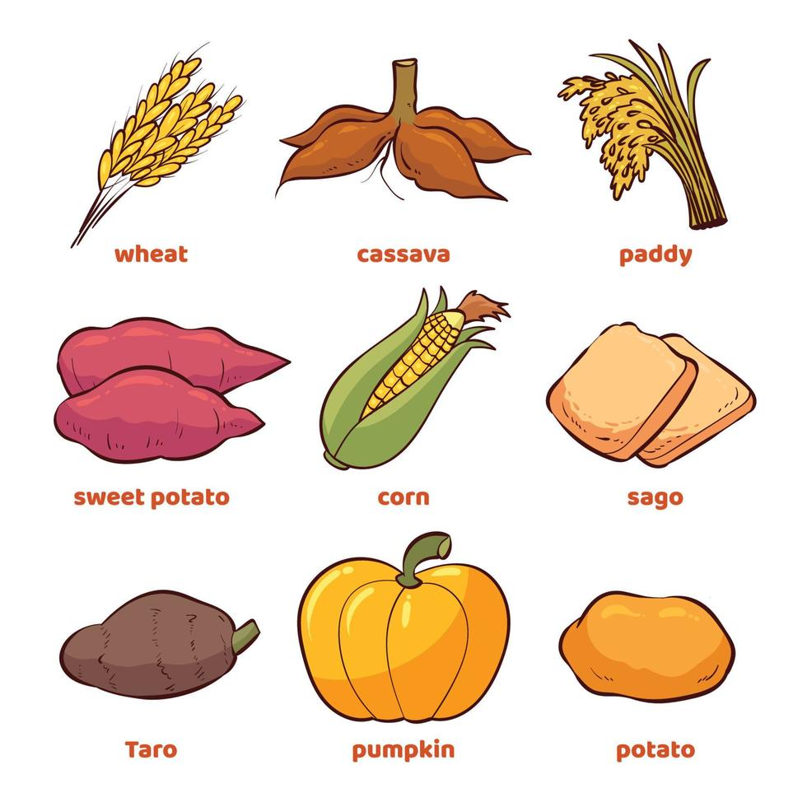
What is a Staple Crop?
Major source of calories
Can be grains, seeds, nuts, or roots
High carbohydrate/starch content
Abundant, easy to grow
Easily stored for long periods
  Globally, 3 main staple crops—rice, corn, and wheat—account for ~ 60% of the world's food energy intake.
What plants do these foods come from & how cultivated?
Notes:
Photo credits: "Crop Fields" by MrHicks46 is licensed under CC BY-SA 2.0.

Slide 18
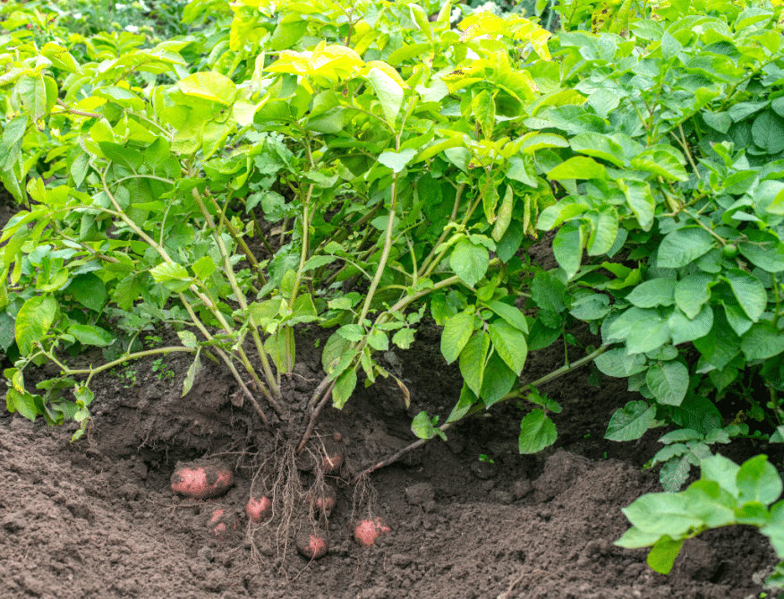
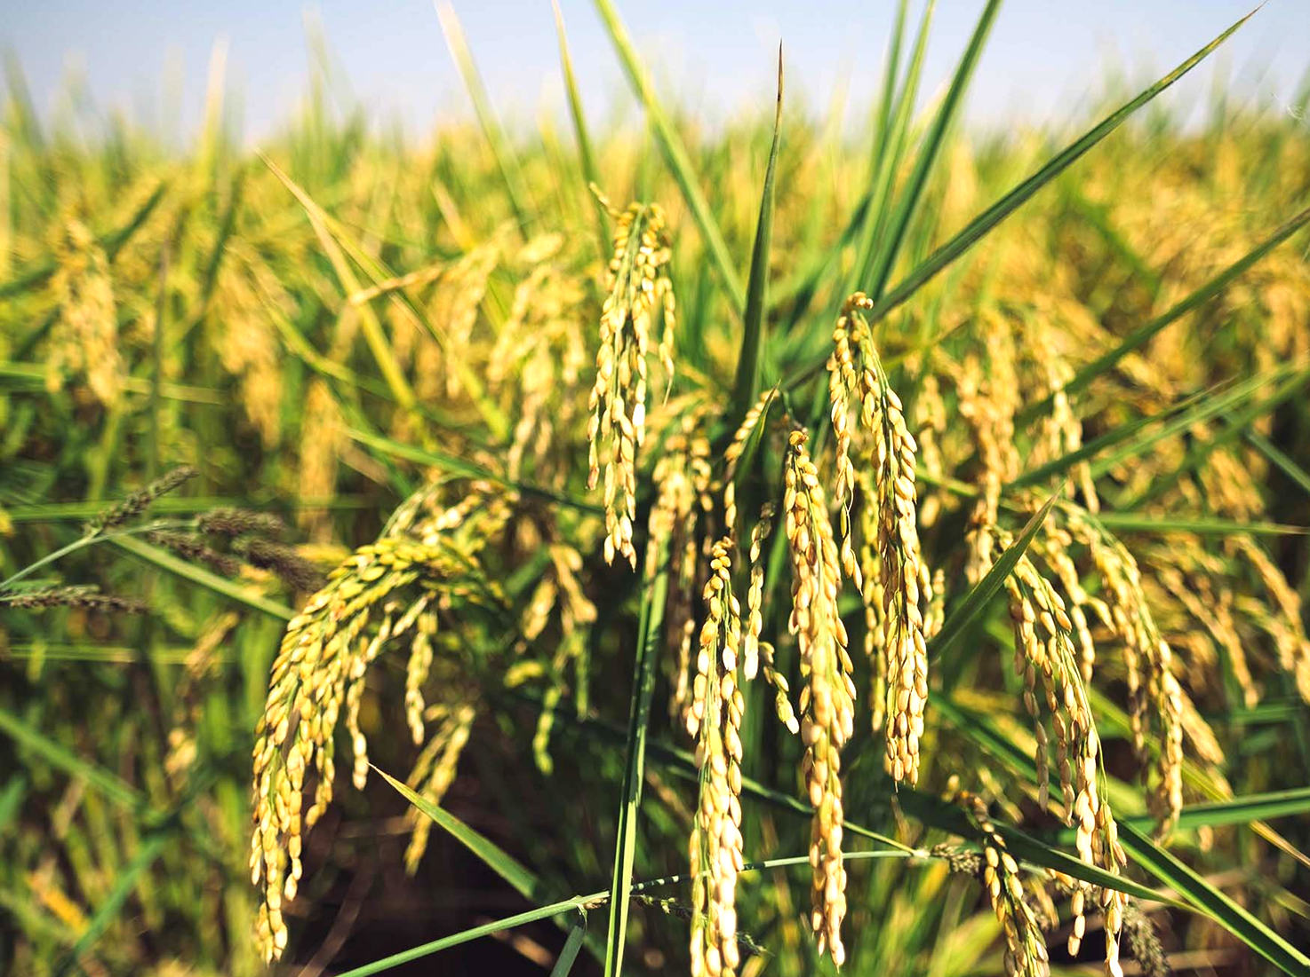
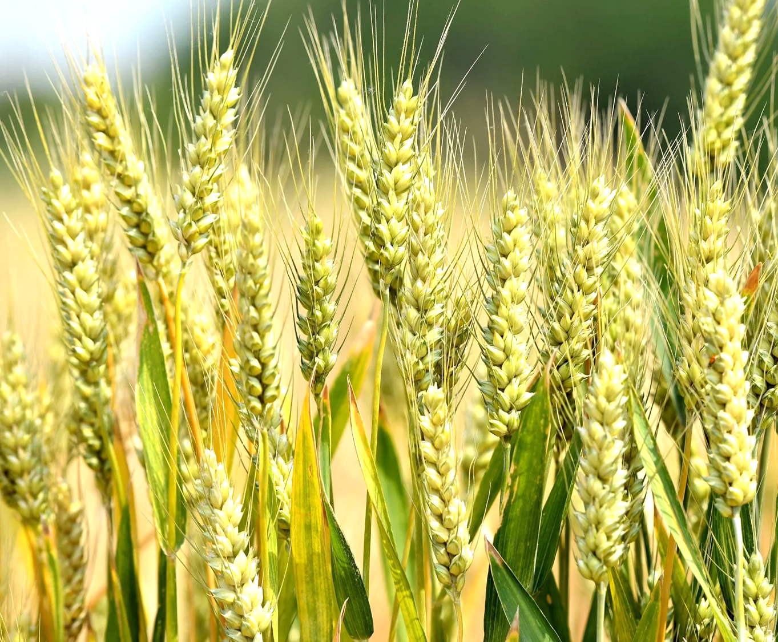
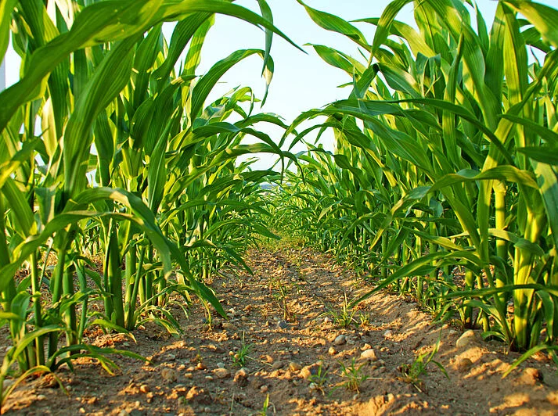
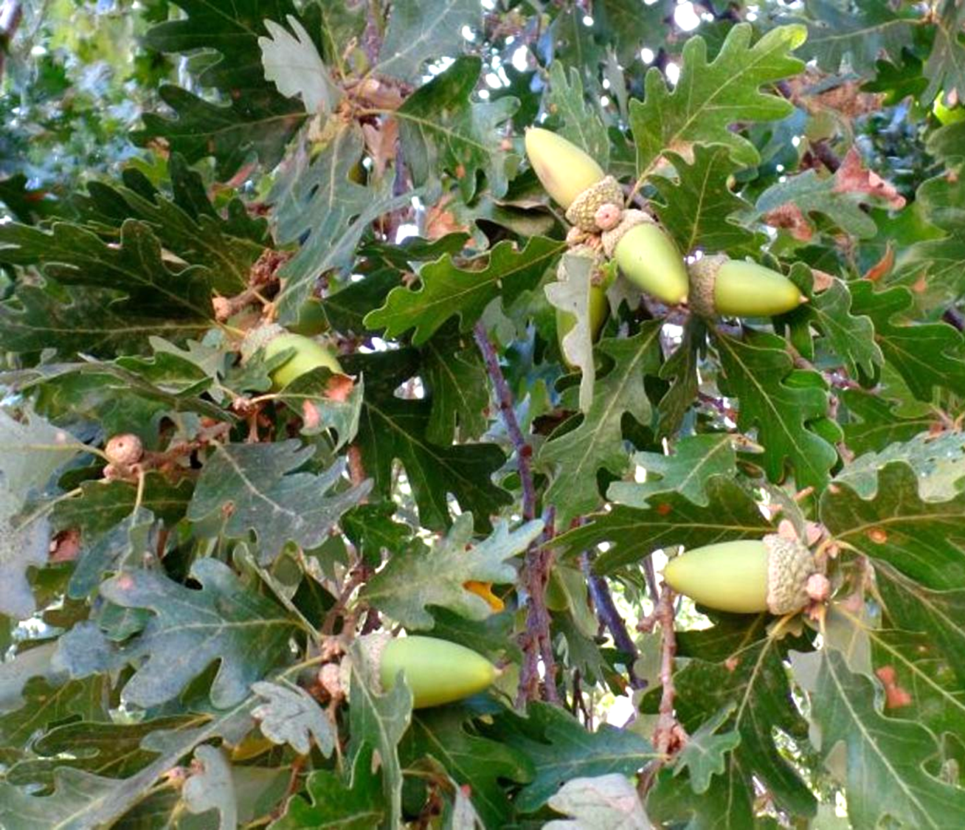
Acorns
Corn
Potato
Rice
Wheat
A
B
C
D
E
Notes:
Potatoes: https://storage.googleapis.com/dsxcuyisbwmqle/when-do-you-quit-watering-potatoes.html
Maize: https://www.koppert.com/crops/arable-crops/maize/?crops=75%3AMaize
Rice: https://www.accrice.com/contact
Wheat: https://www.alamy.com/the-soon-to-mature-wheat-in-west-coast-new-area-in-qingdao-shandong-province-china-on-may-24-2025-image679544679.html
Acorns: Judy Sanregret https://santamariatimes.com/lompoc/lifestyles/columnist/on-the-central-coast-the-valley-oak-is-queen/article_6dad19af-1bfd-5bce-ab1e-a3b4c33c70c6.html

Slide 19
Staple Crops Jigsaw Activity: Home/Expert Groups
Research information on each topic within your home group and summarize your research to your group..
Take notes on each topic, your own research & that of your expert group members, so that you can report out to others not in your group.
Jigsaw to home groups, so that one representative for each staple crop is in a group together.
Summarize your information researched in your expert group, and take notes on each staple crop presented.

Slide 20
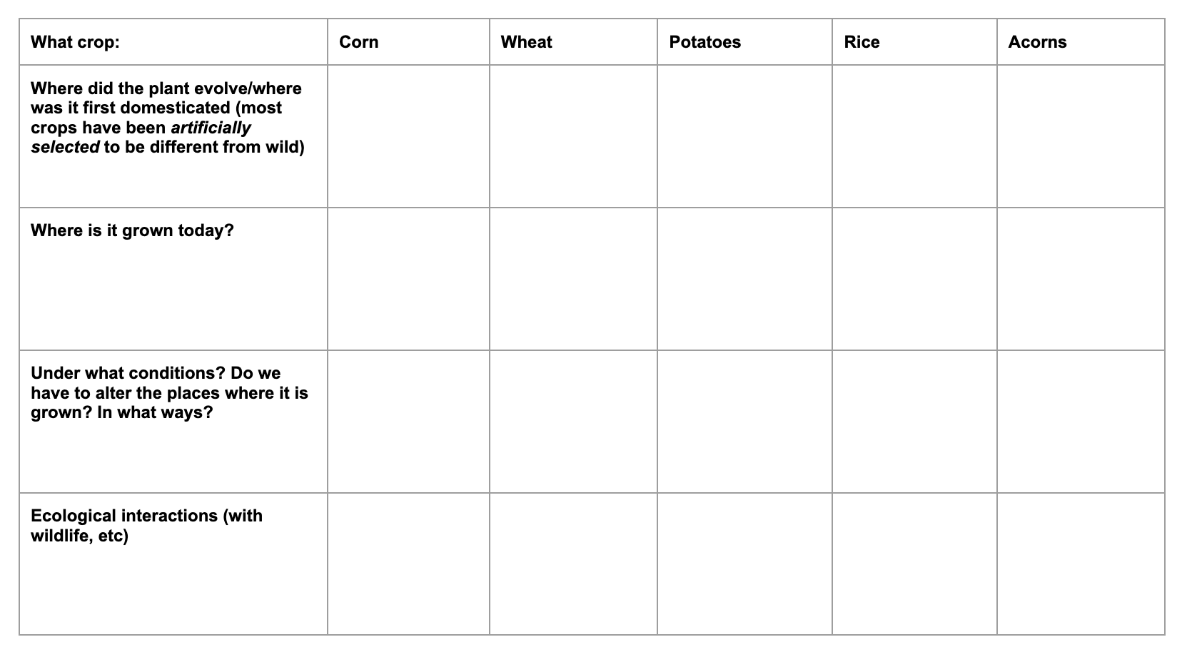

Slide 21
Ecosystems & Agriculture (big picture/overview)
Humans are omnivores: we have choices
  We can get all our protein from plants
  We can incorporate other sources of protein as well
Traditional food systems
  Foods were largely seasonal–what was nearby and available (river, coast, plains, etc)
  Included insects for many cultures

Slide 22
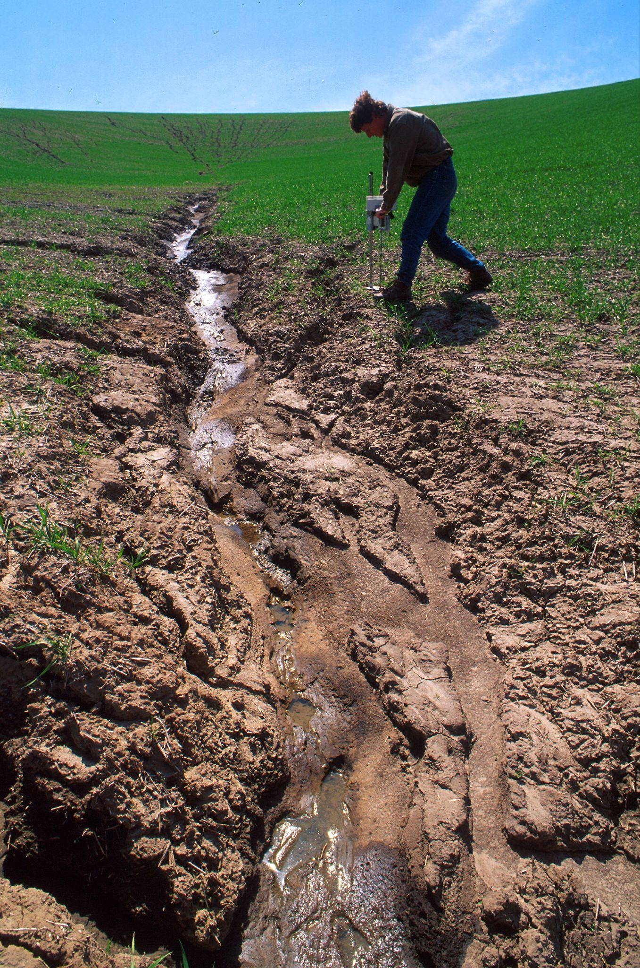
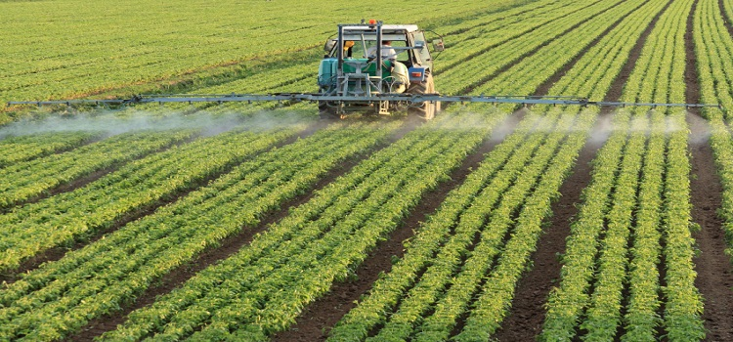
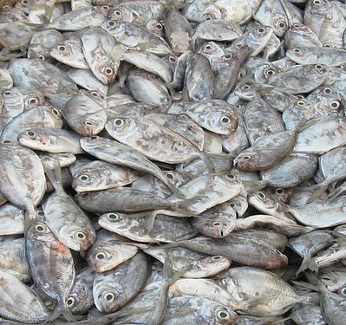
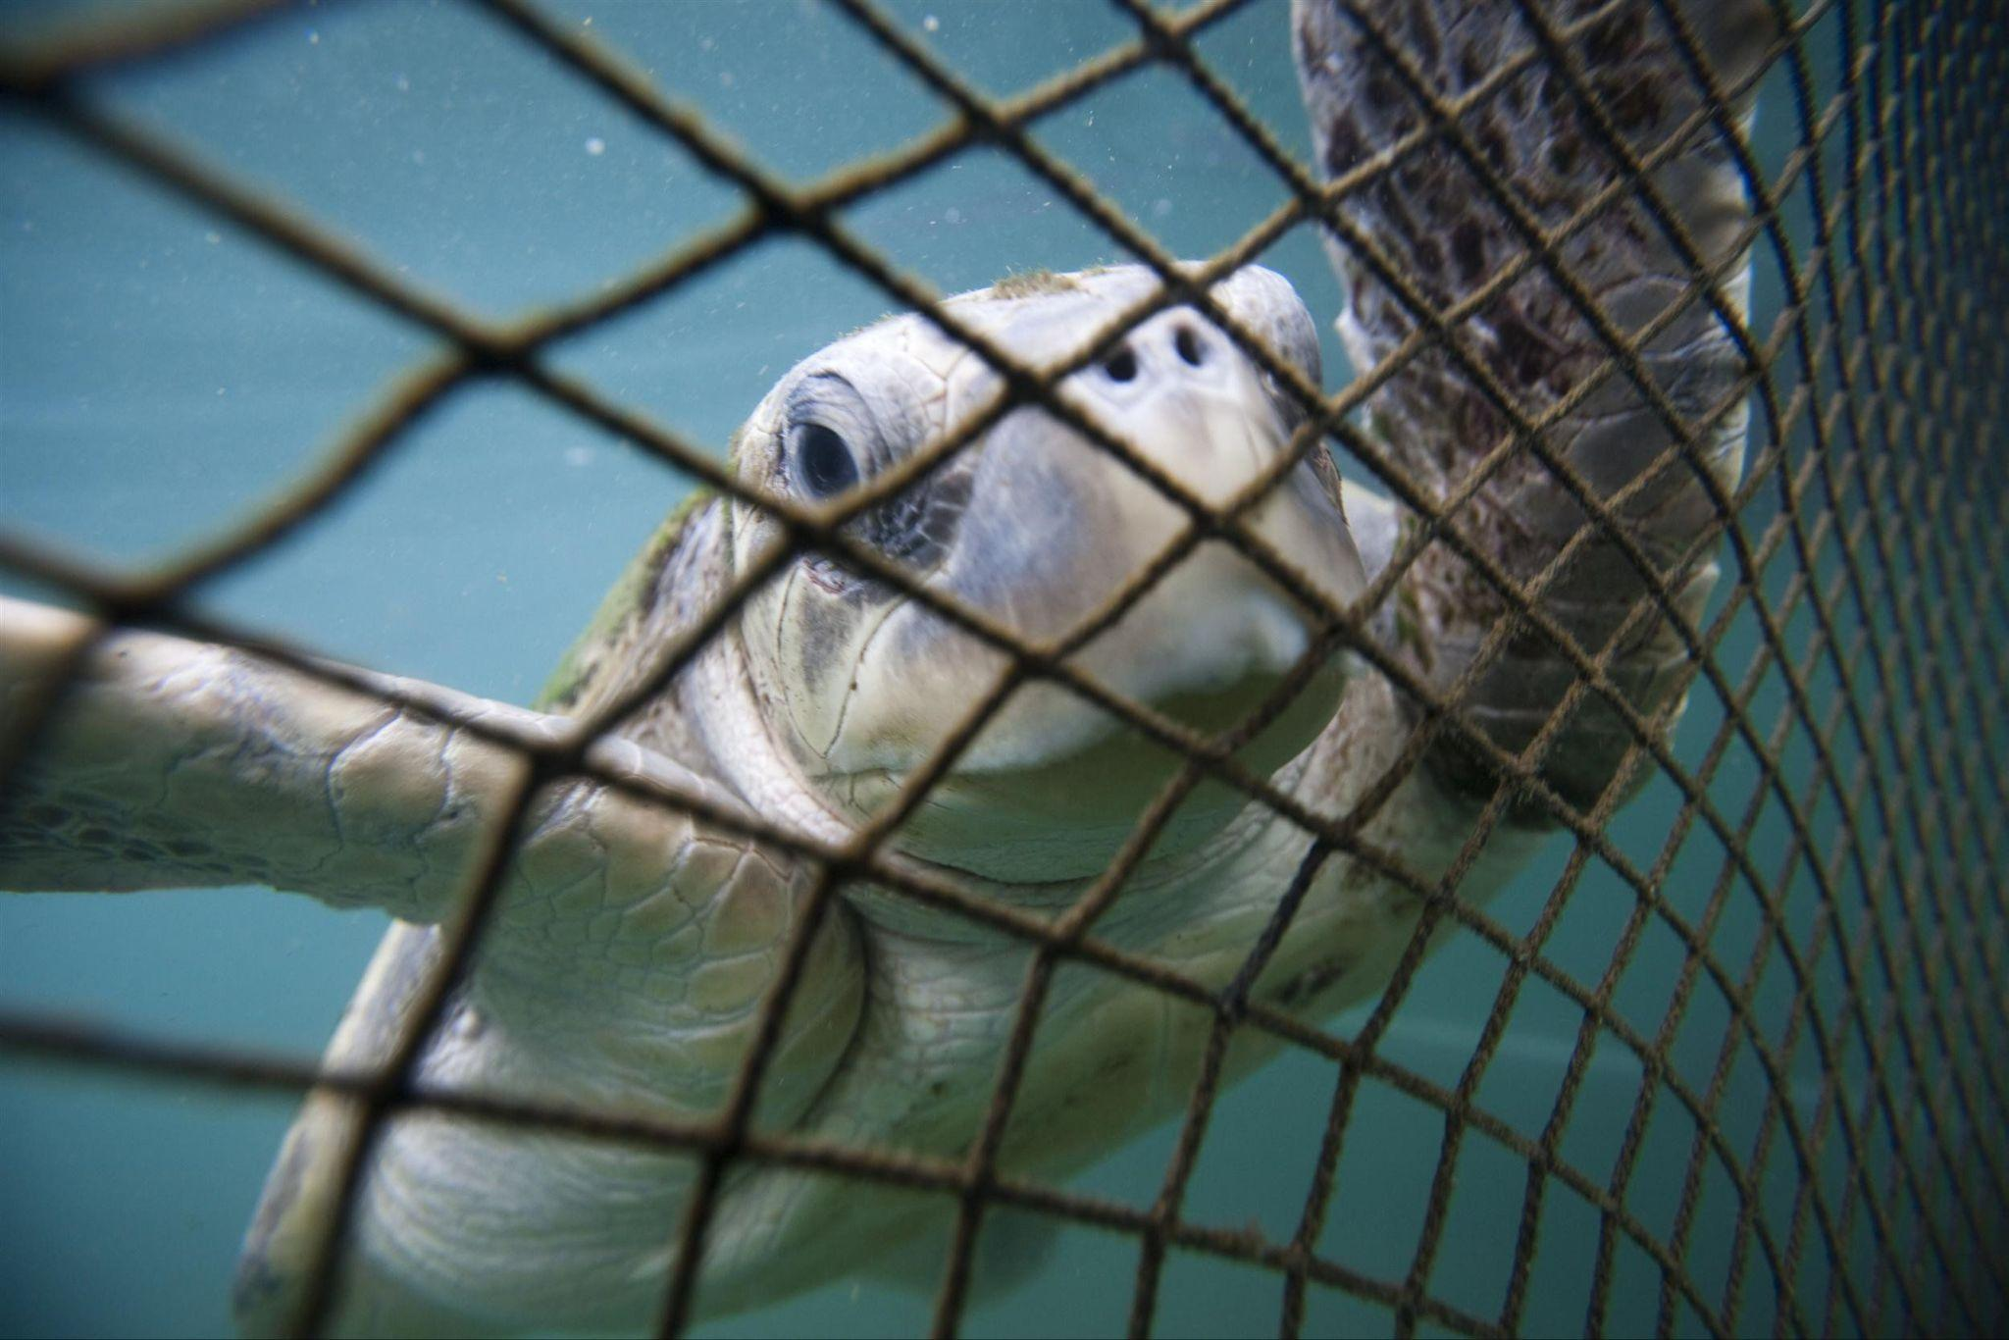
Industrial-scale food production can create environmental harm.
Discuss: What are the issues with modern food production shown in these images?
Notes:
Clockwise: Soil erosion/runoff; Pesticides; Bycatch; Overfishing
Erosion: https://commons.wikimedia.org/wiki/File:Erosion.jpg
Pesticides: https://engineersnetwork.org/category/types-of-engineering/agricultural-engineering/
Bycatch: Biology Project: https://www.youtube.com/watch?v=6ElV-XMeCus
Overfishing: FalseTrevally.jpg: Ravi Yedavalliderivative work: Haplochromis, CC BY-SA 3.0 <https://creativecommons.org/licenses/by-sa/3.0>, via Wikimedia Commons

Slide 23
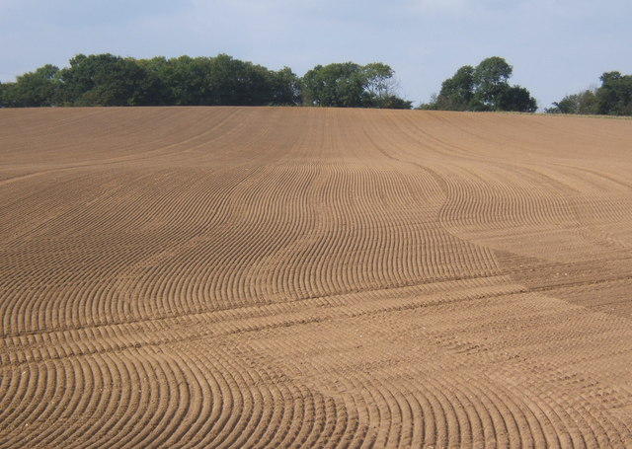
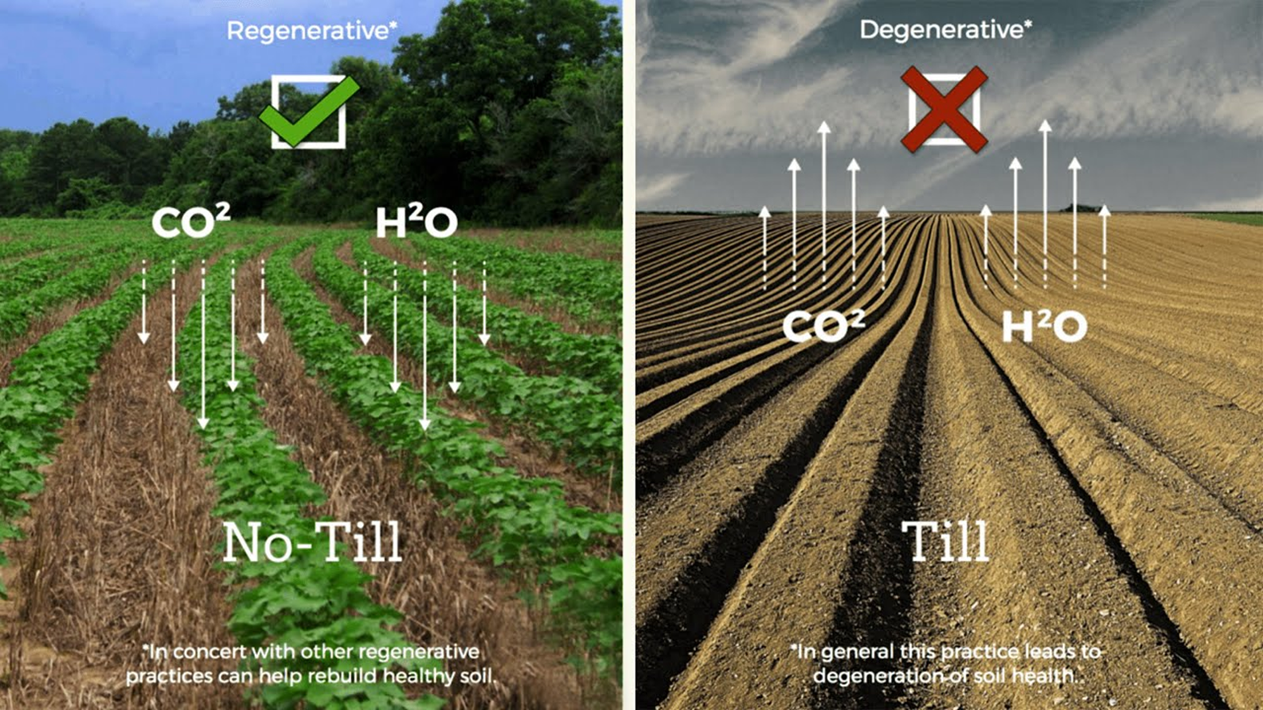
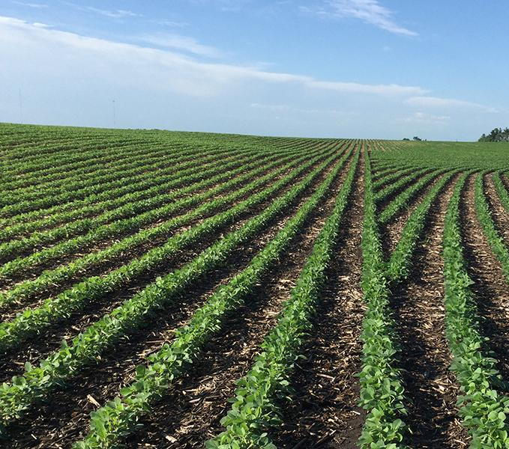
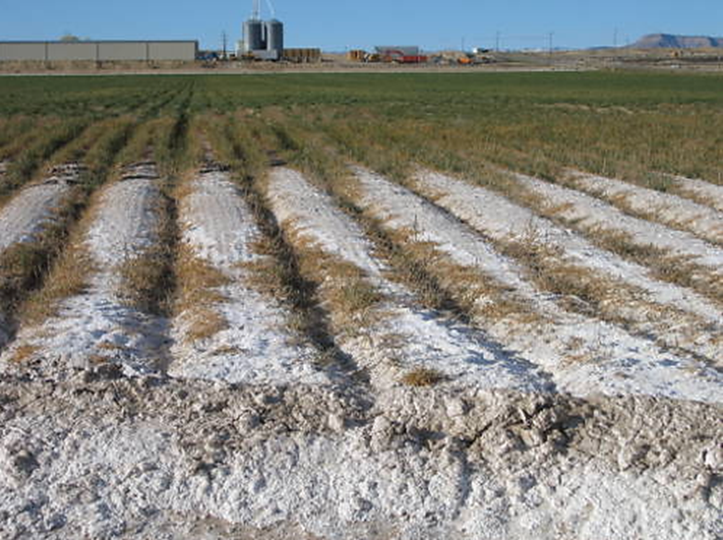
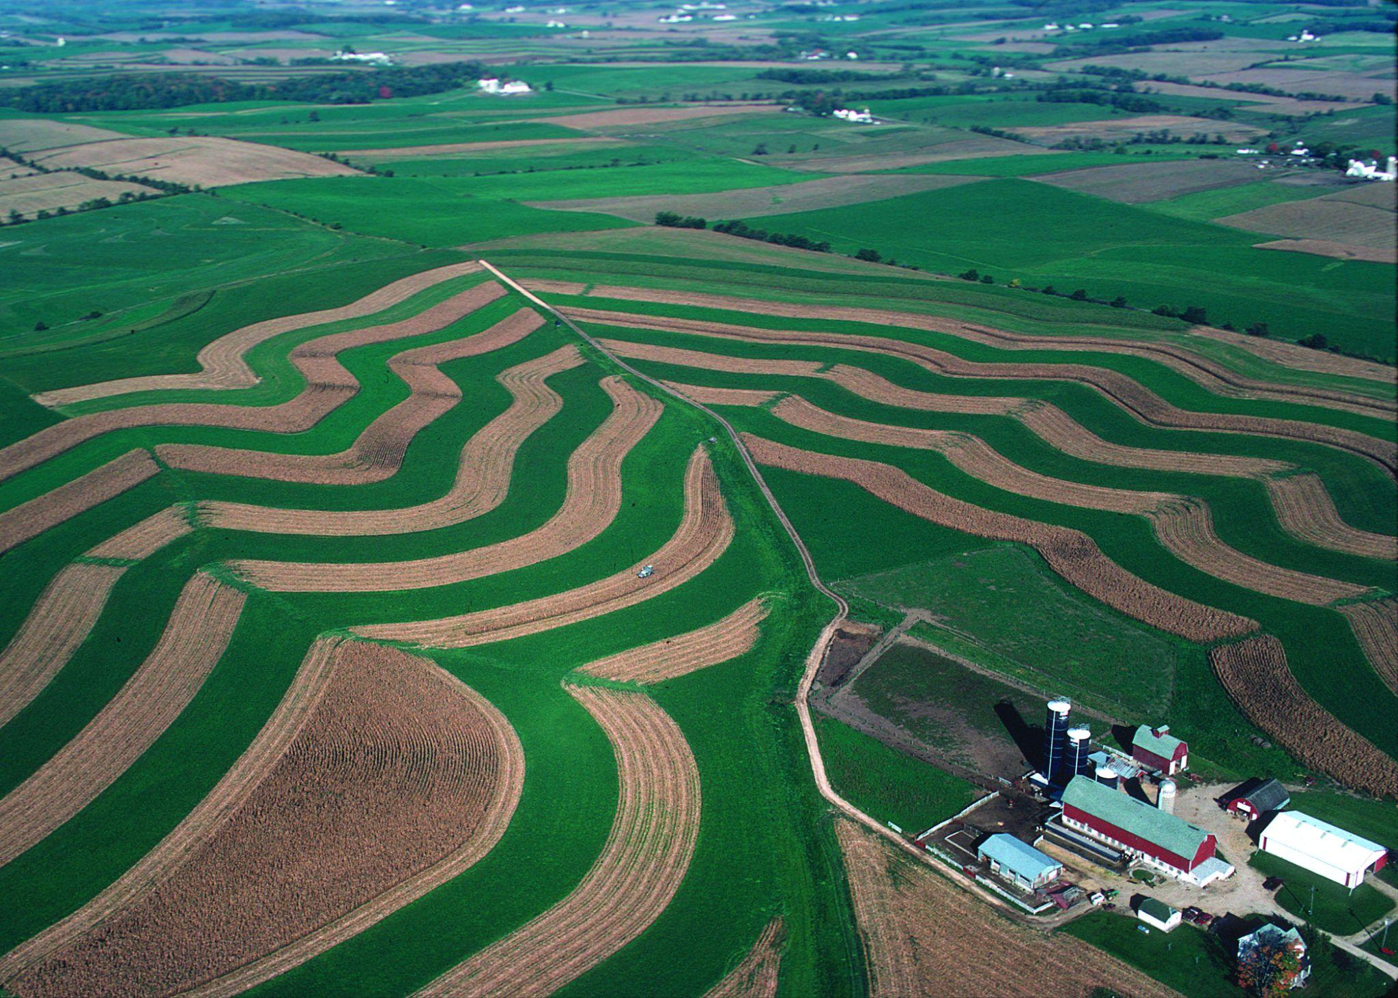
Some types of agriculture reduce soil and water quality.
Reduced soil and water quality can reduce yields in the future.
Notes:
No-till/Till: https://us.noharm.org/news/dirt-climate-change-regenerative-agriculture-and-health-care
Salt-affected agricultural soil in Grand Valley, Colorado near Fruita. (Photo courtesy of Don Suarez, USDA-ARS)
Straight rows: https://www.tonnerprecision.com/products/precision-planting/vdrive
Contour stripcropping: Ron Nichols / Photo courtesy of USDA Natural Resources Conservation Service.
Tilled field: Andrew Hill / More cultivation patterns in large field rising north of Offton (wikimedia commons)

Slide 24
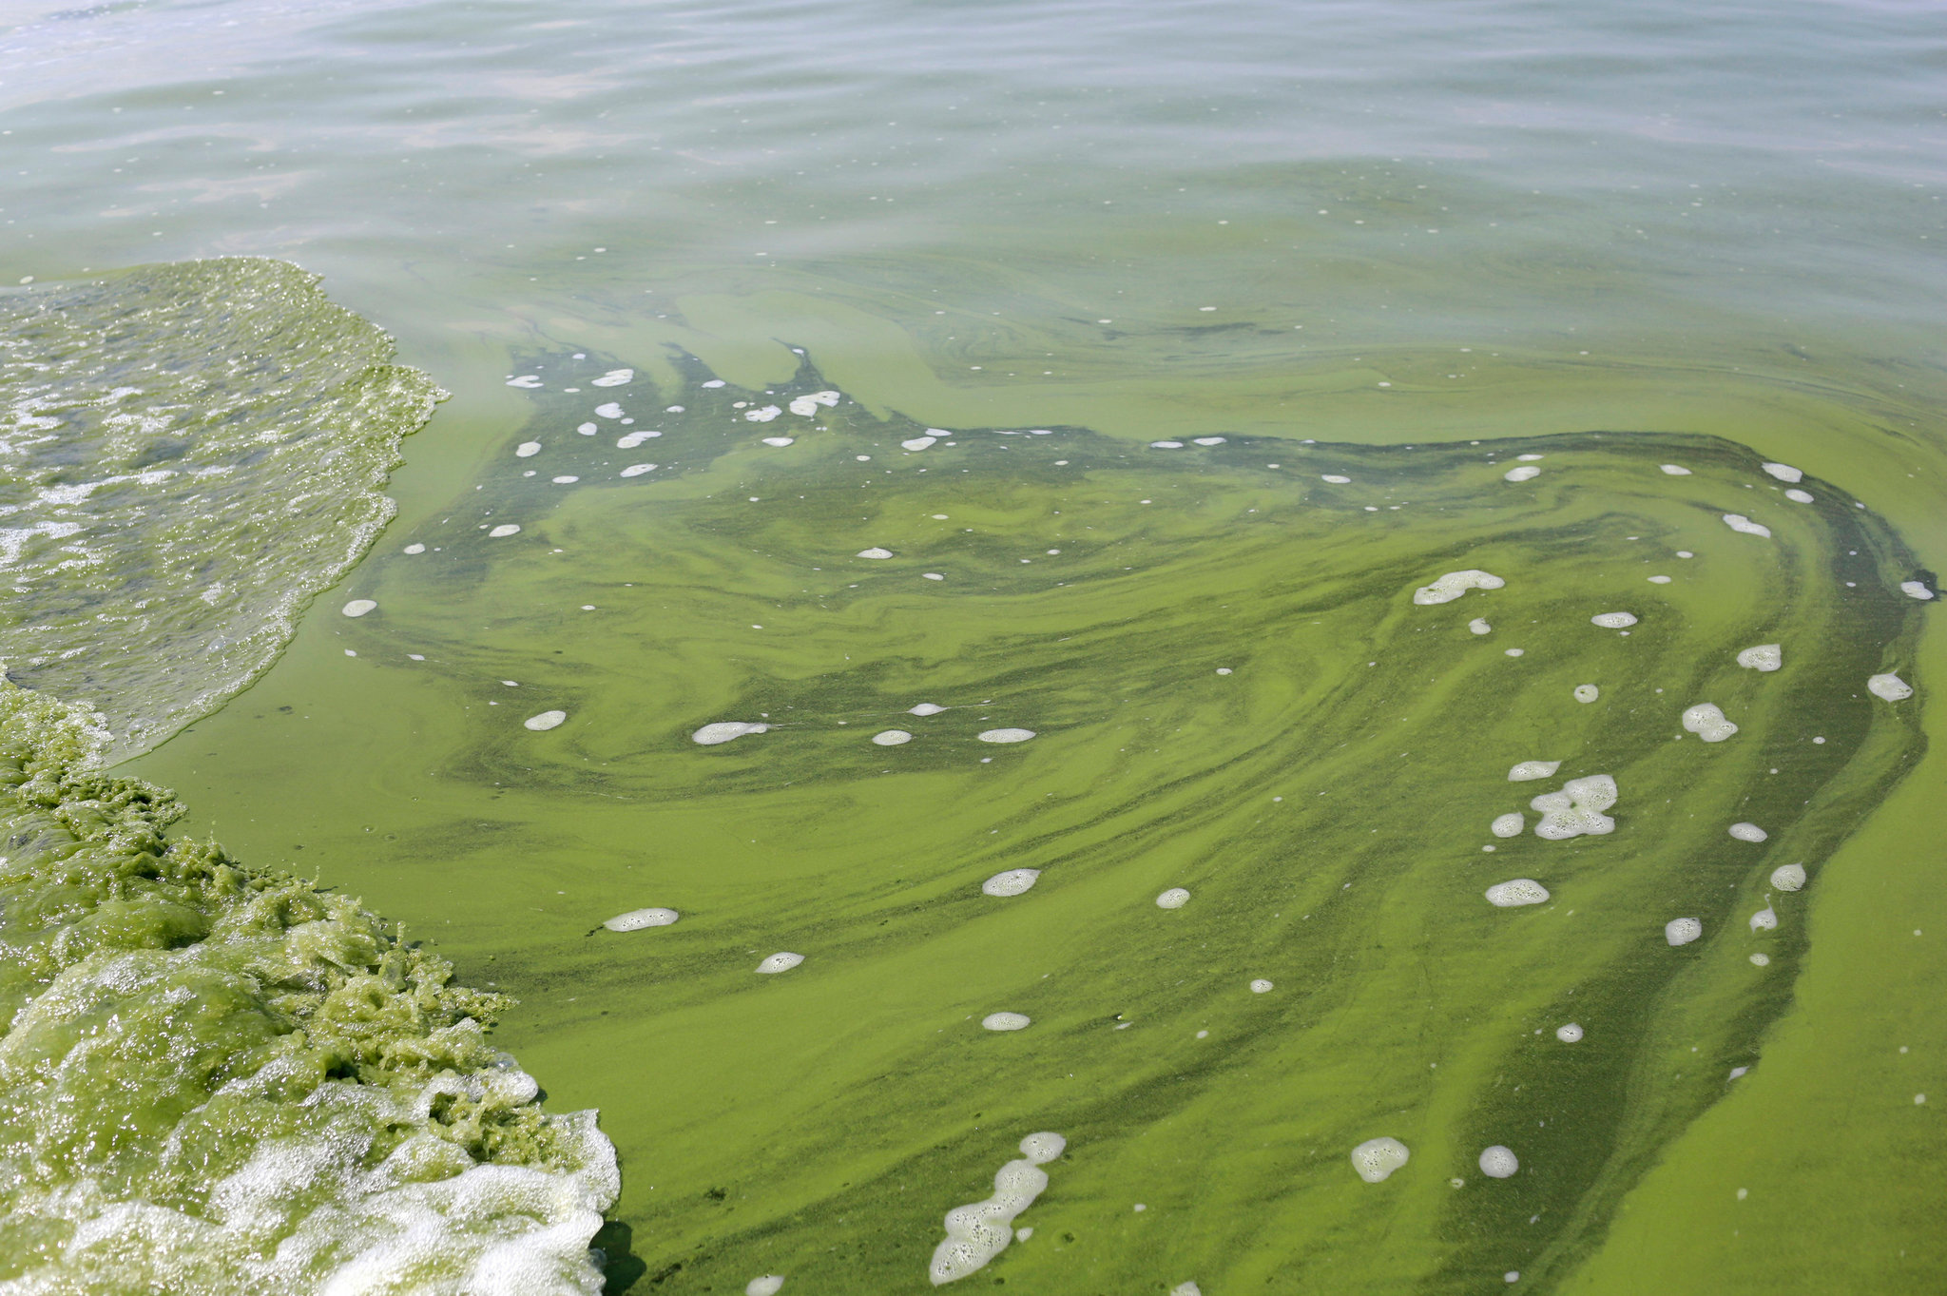
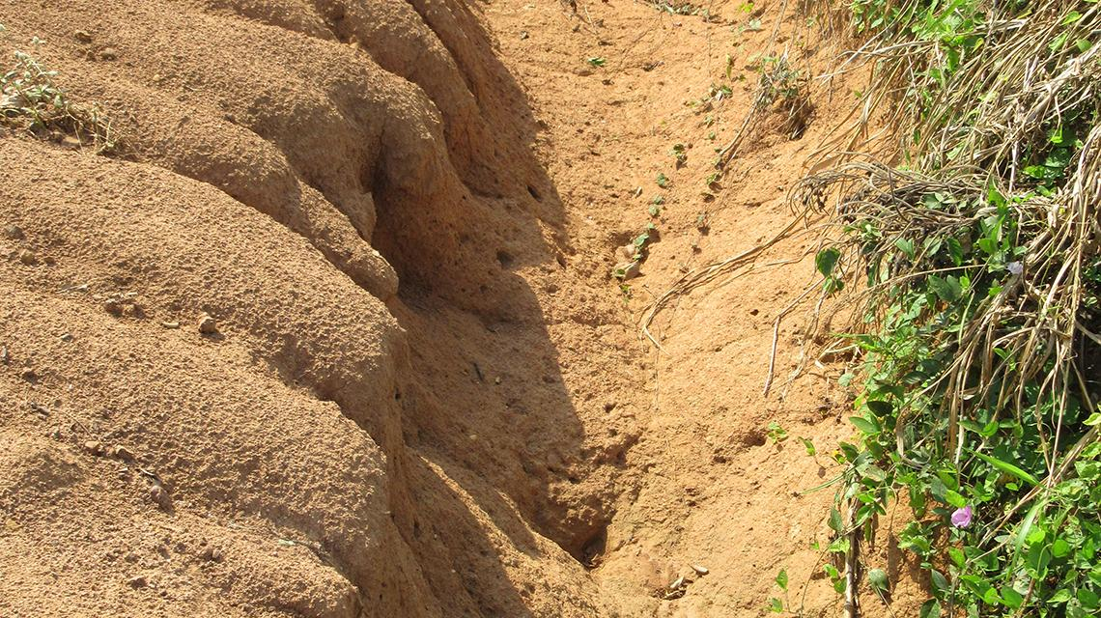
How do we modify environments to accommodate crops?
What are some environmental consequences?
Soil erosion: Industrial agriculture practices such as tilling can loosen root structure in soil, causing the soil to blow away with C, P, N plant nutrients.
Runoff: from loosened soils can leach excess Nitrogen
  Into surface waters, which can lead to eutrophication
  Into groundwater, which can lead to nitrates contaminating wells (Blue Baby Syndrome)
Water: Changing cycles & quality & quantity
Notes:
Erosion: https://classnotes.ng/lesson/environmental-hazard-soil-erosion-jss3/
Algae: Haraz N. Ghanbari/Associated Press

Slide 25
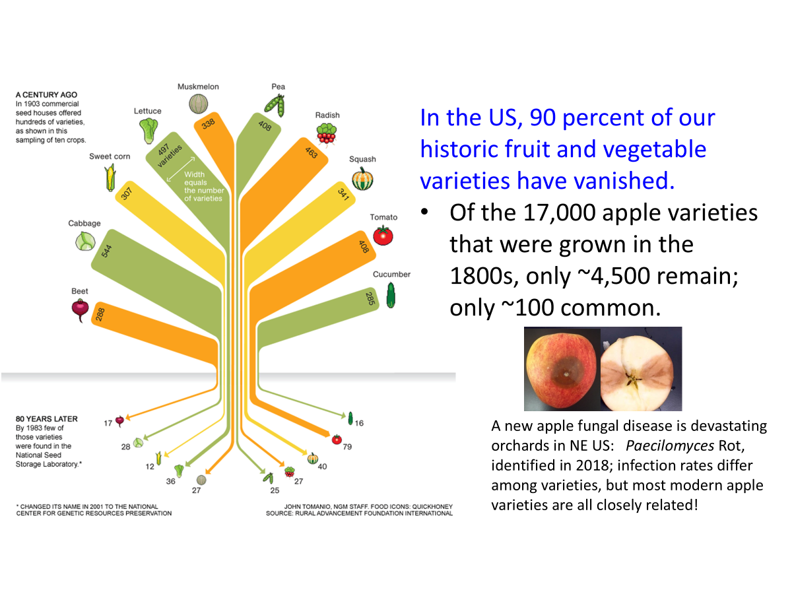
How do we modify environments to accommodate crops?
What are some environmental consequences?
Biodiversity: of crops & wildlands
In the US, 90% of our historic fruit and vegetable varieties have vanished
  17,000 apple varieties grown in the 1800s
  ~4,500 remain
  ~100 are common
Apple fungal disease in NE US: Paecilomyces identified in 2018
  Infection rates differ among varieties but most modern apple varieties are all closely related

Slide 26
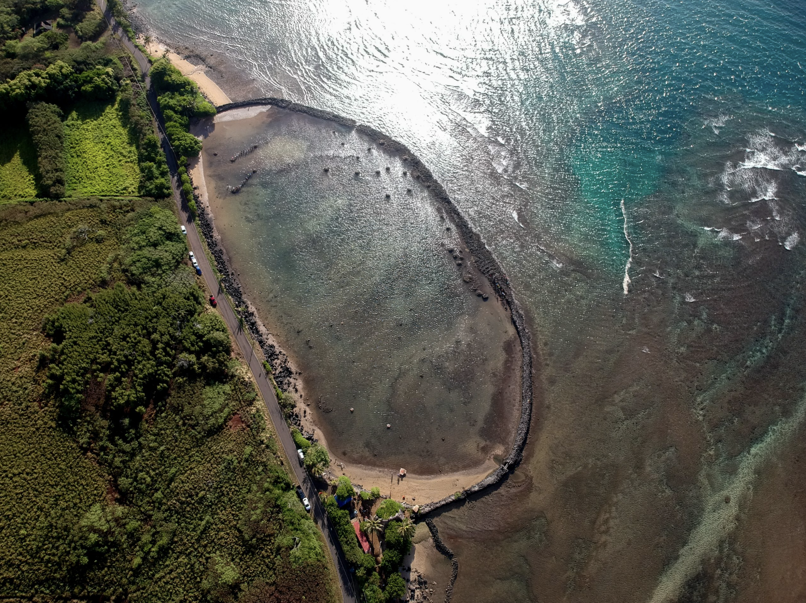
What can we learn from Indigenous food ways about sustainable food production?
What about regenerative agriculture?
What about the slow foods movement?
What do these approaches have in common?
Place-based, small-scale agriculture and aquaculture technologies
  Acorns in California
  Hawaiian fishponds: shallow areas of a reef flat surrounded by a low lava rock wall (loko kuapa) built out from the shore
Notes:
Kahina Pōhaku in Moanui, Molokaʻi - Photo by Scott Kanda

